Slide 1
DAY 4 - Patient engagement session
Meet your fellows!
Blair Schneider - Sophie's Hope Foundation
Naomi Abrahams - The Choice Research Lab
Melanie Isele – DEBRA Austria
Giulia di Santis – HHT Italia
Christhyl Ceriche - Dimus Chile

Slide 2
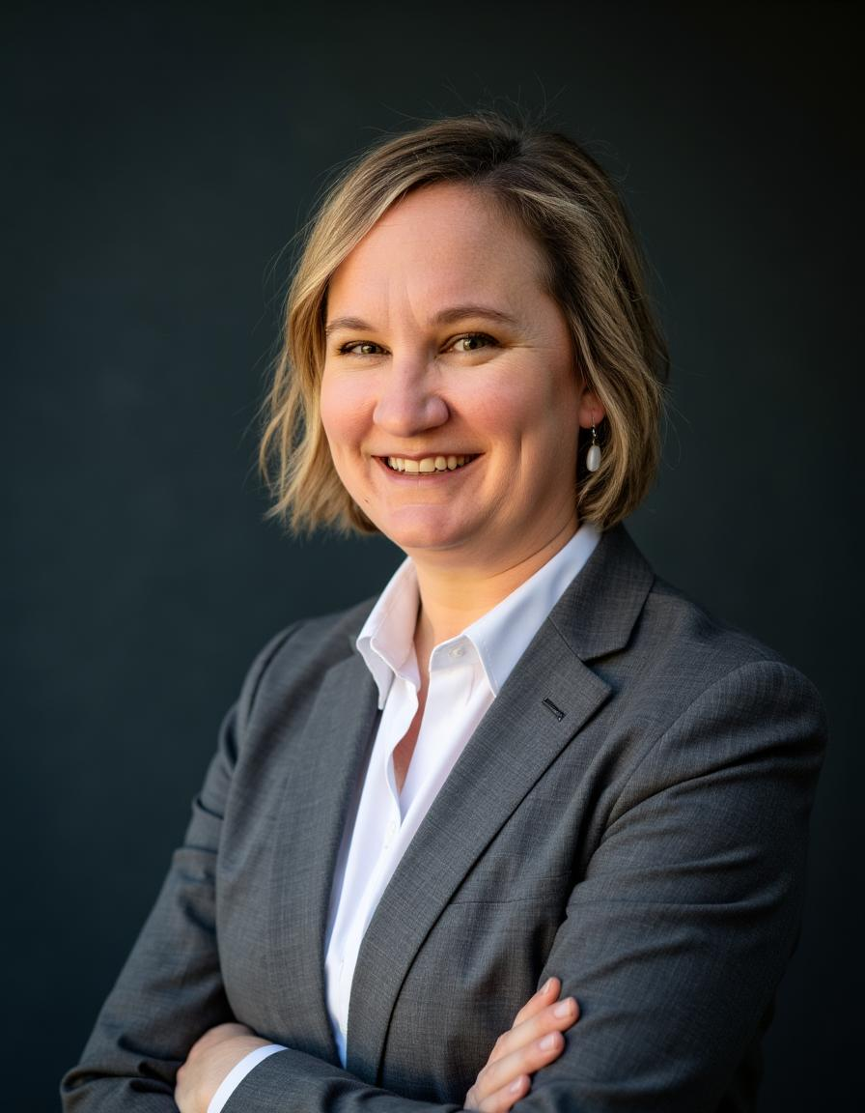
Blair Schneider - Sophie's Hope Foundation

Slide 3



EURORDIS PATIENT ENGAGEMENT SESSION
Sophie‘s Hope Foundation
cure GSD1b
Driving better outcomes for GSD1b.

Slide 4


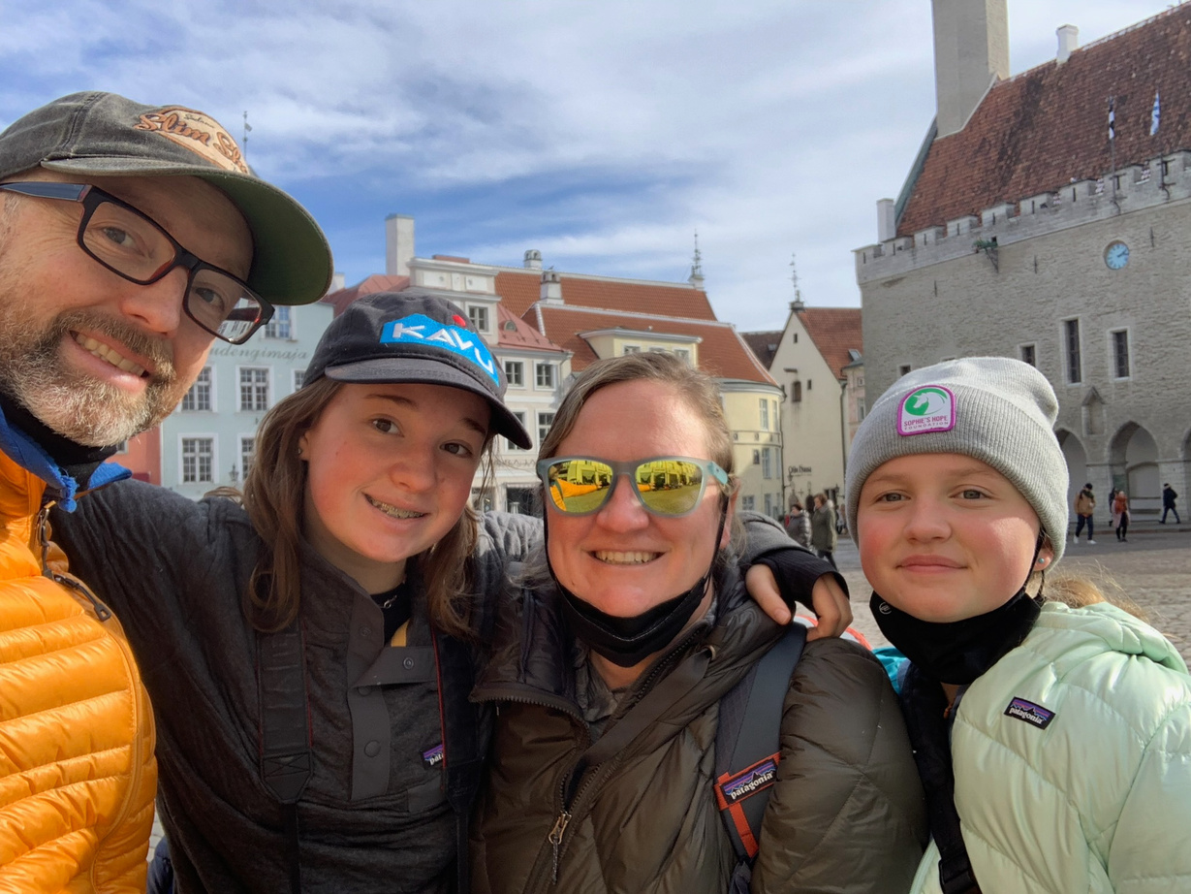
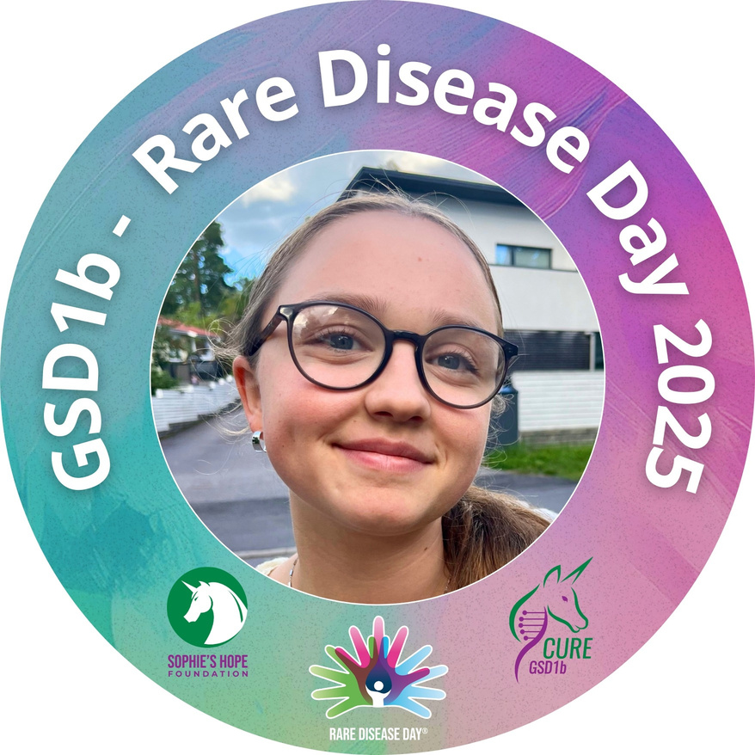
Blair Stone-Schneider
Executive Director
Sophie’s Hope Foundation
Cure GSD1b
Mom to Sylvi, age 16, with GSD1b
Notes:
Science communication and community engagement. Bridge analogy
First paid employee, was previously a volunteer on board.
Parent to a teenager with 1b
Wear many hats.

Slide 5
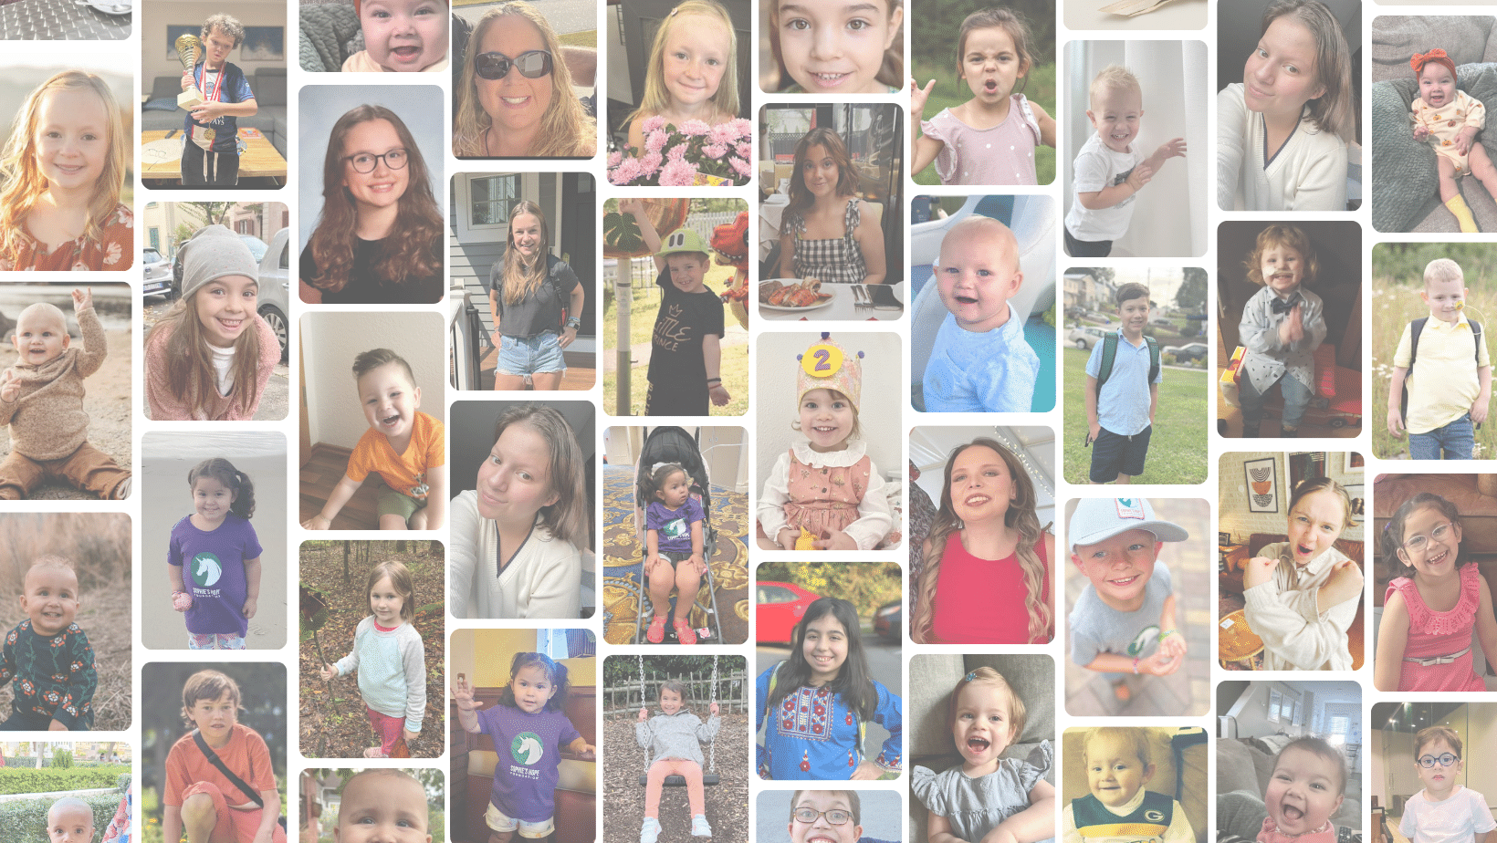
Driving research through funding, coordination and collaboration.
Our Mission
1
Driving research through funding, coordination and collaboration.
Raising global awareness among the general population, governments, the pharmacuetical industry and regulatory bodies.
2
Raising global awareness among the general population, governments, the pharmacuetical industry and regulatory bodies.
Three focus areas:
Supporting patients and caregivers through community building and education.
3
Supporting patients and caregivers through community building and education.
Notes:
Started out research-focused
Spreading awareness and community building aspects were to key to long-term success, and reaching our goal, which is to cure GSD1b.
1b has unique challenges and small population, connecting with other 1b and building community is key.

Slide 6
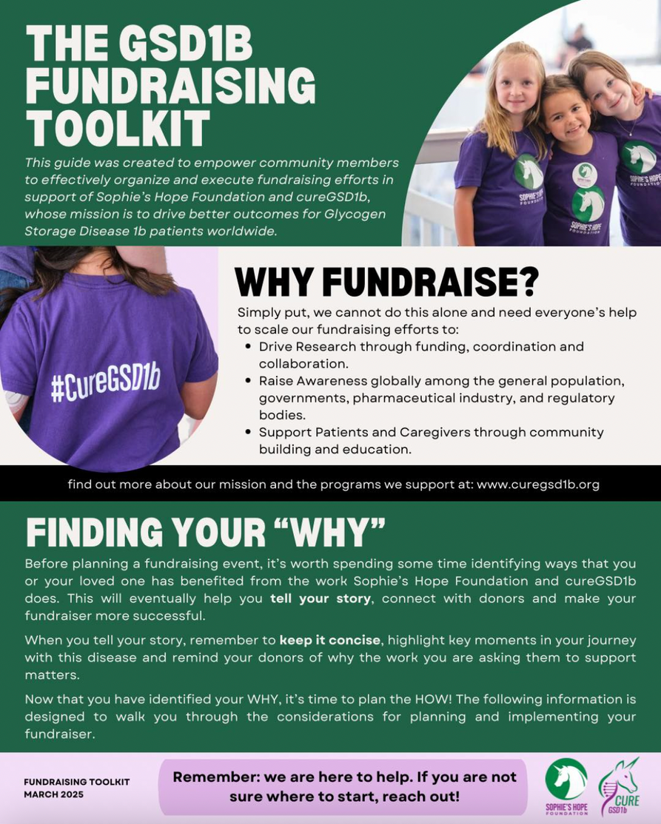
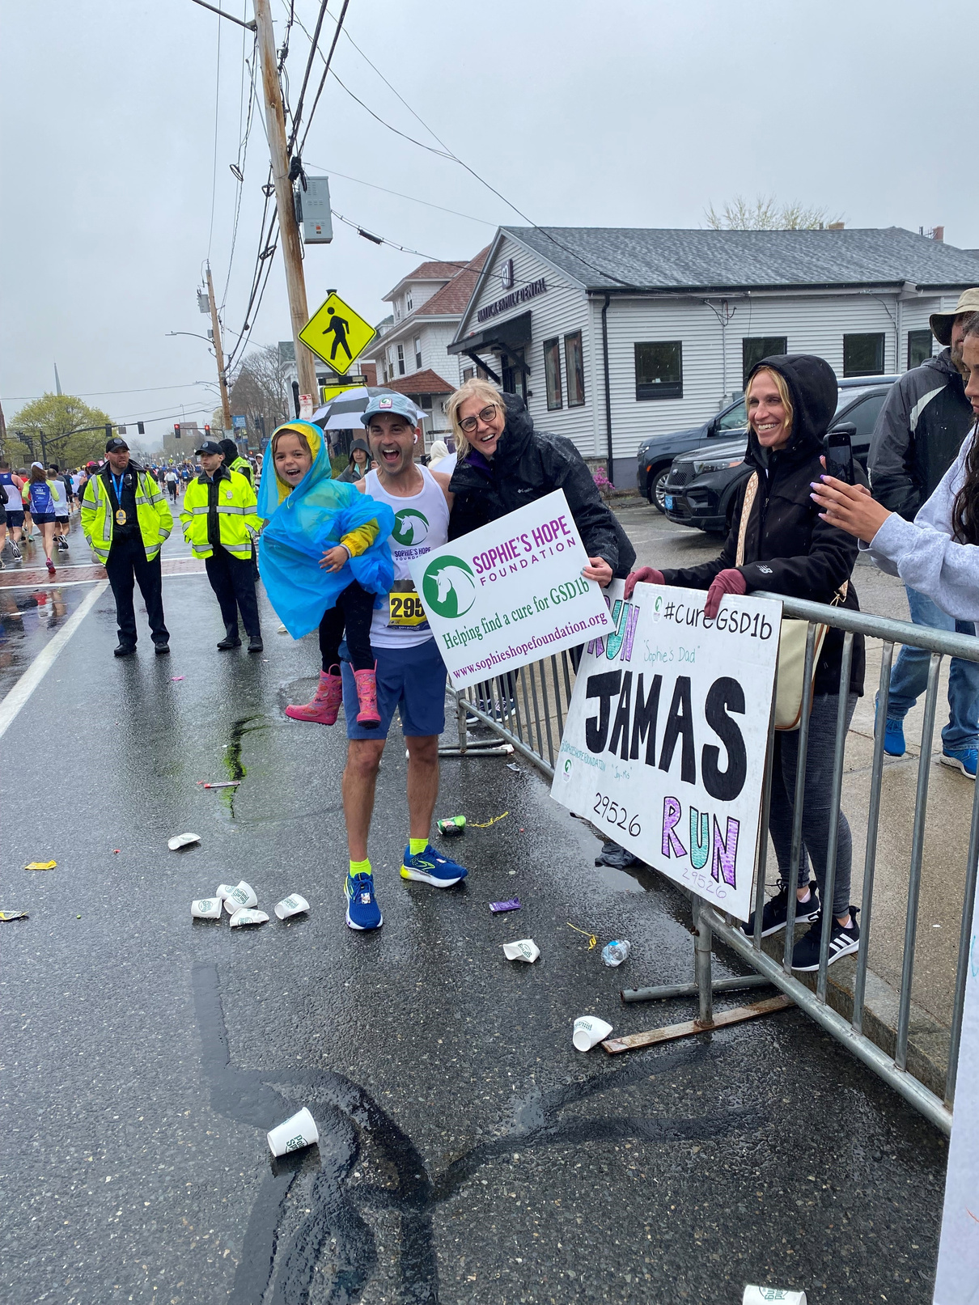
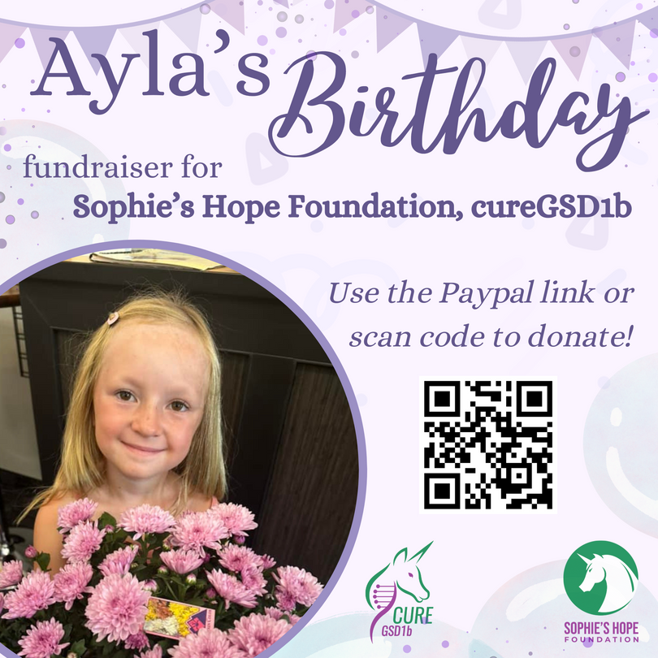
Fundraising:
community driven
Notes:
community driven, grassroots. Marathon, golf tournament, etc. Raised 500,000 last year.
Currently no funds provided from industry.
Are applying to more grants over time to diversify funding sources and create sustainable funding model for the long-term.
Fundraising toolkit just completed.

Slide 7

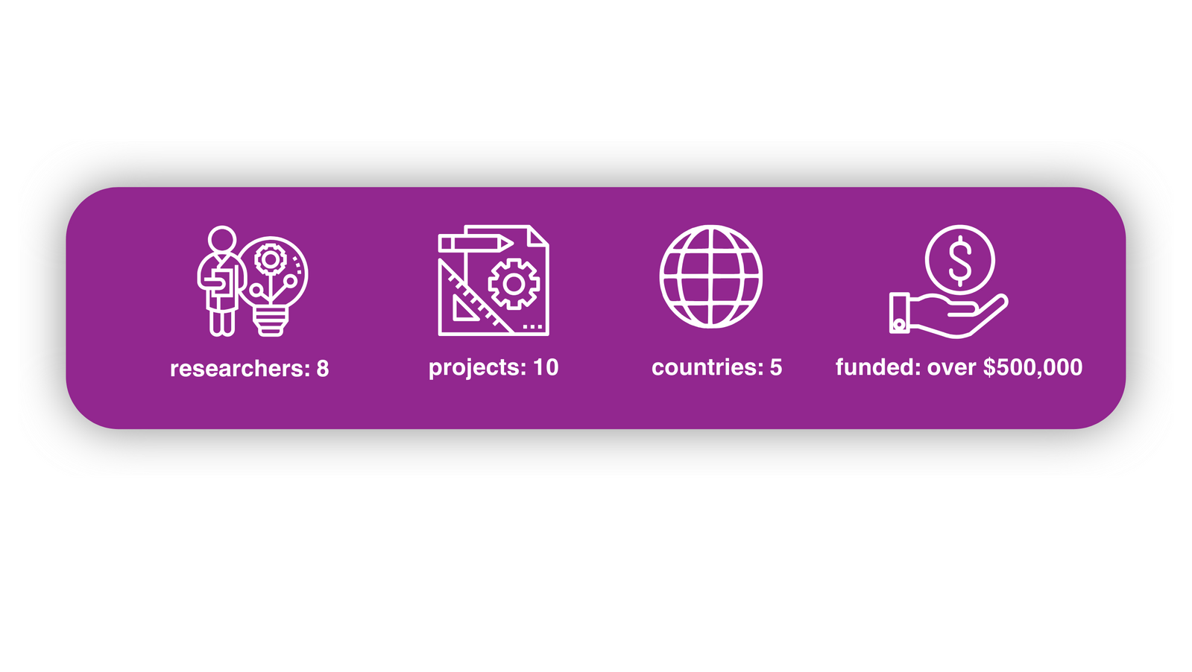
Funded projects:
from 2020 to present
  Small grants to individual researchers (Europe and the U.S.)
  Multi-year retrospective Natural History Study (U.S.)
  New conditional knock-out mouse model (Italy and the U.S.)
  International Workshop on Empagliflozin in 1b (Europe, U.S., Middle East)
  GSD Value Project (worldwide)
Notes:
Only figures from 2020- early 2025.
summary of total from graphics.
Projects large and small, some in collaboration with other patient organizations-- again, stronger together.

Slide 8

Jonah
Pournazarian
GSD1b Fund
Upcoming
projects:
Prospective Natural History Study
International, multi-site
Five-Seven Year Project
Estimated: $1.25-1.5 million
Patient Data Registry
Worldwide
Multi-year, ongoing
Critical for future clinical trials
Notes:
- NHS, required step in the road to a cure, clinical trials.
- Data registry, key for understanding patient presentations, locations, #s
contact registry, tricky compliance, but in contact with 225 patients in 48 countries.
- Glycosade and mannose.

Slide 9
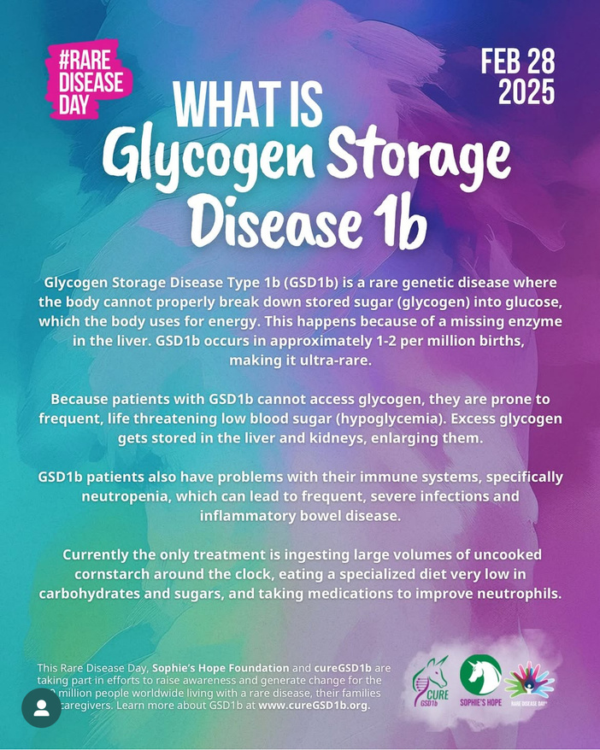

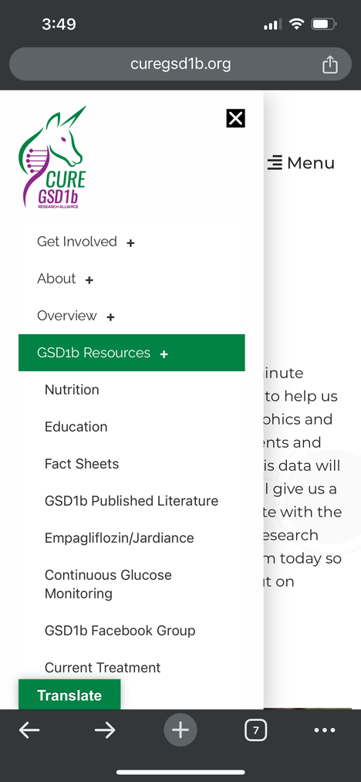
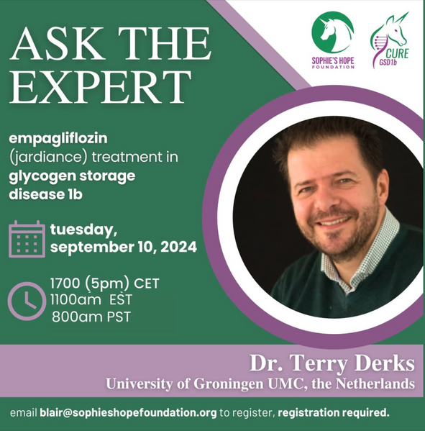
Education and
Awareness:
  www.cureGSD1b.org website
  Educational outreach in many forms
    webinars
    multi-media
    direct
  Culturally appropriate and geared towards the needs of the audience, including language
Notes:
Creating education and awareness-- huge component of what we do.
Various forms, from creating materials, direct communication with caregivers, clinicians, industry.
Culturally appropriate and inclusive. Concrete example: translation of materials, Ask The Expert series.

Slide 10
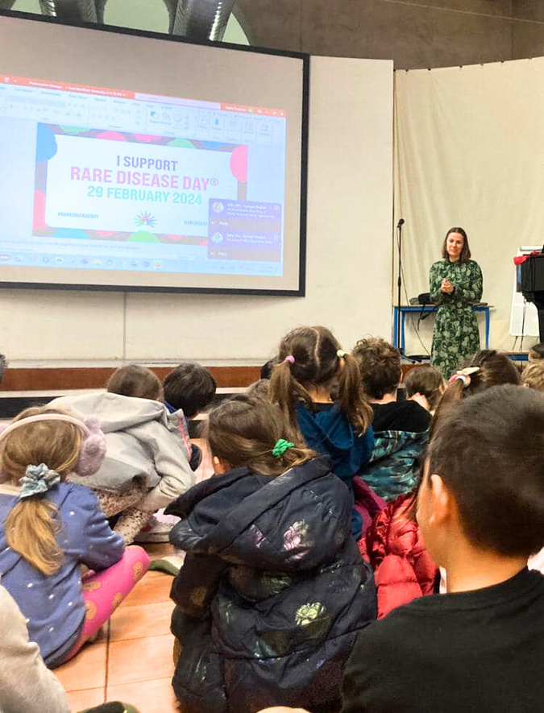

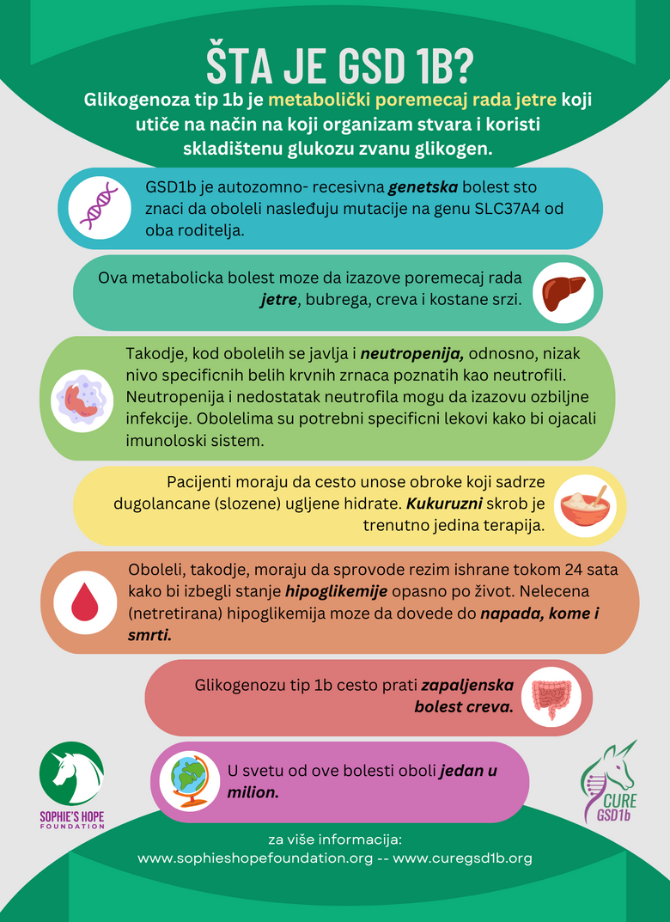
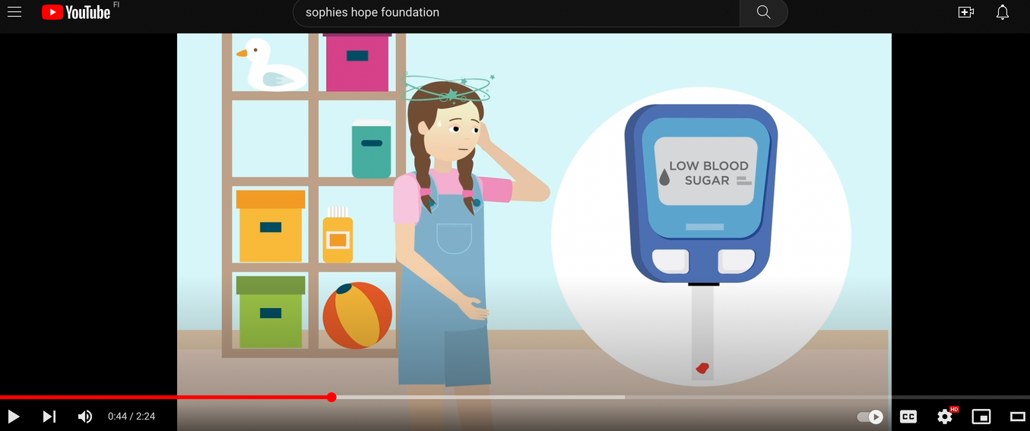

  In-person events
  Translated infographics
  Materials in various formats:
    youtube (video)
    digital
    print
Notes:
In-person support for patients. Nina's Rare Disease Day 2024
Educational videos on GSD1b.
The fact sheet-- now available in 9+ languages.
Other infographic materials intended to educate and share.
Friends of GSD1b Book

Slide 11


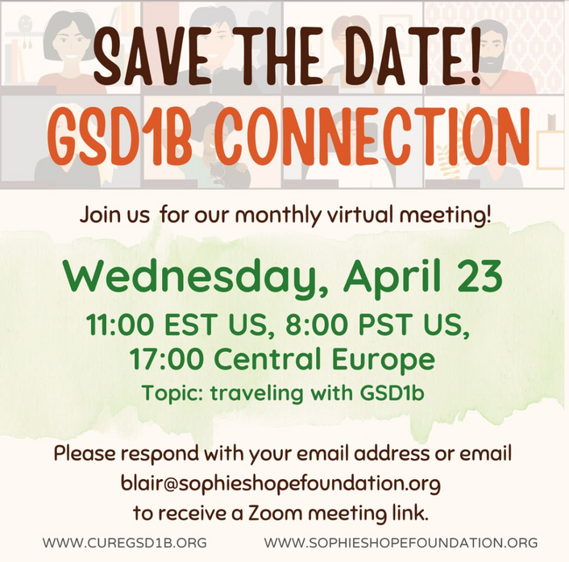
Community building:
  Encourages patients and caregivers
  Informs care and management
  Builds trust within the GSD1b community
  Connects patients worldwide
  Increases education and awareness
Notes:
Key to the success of our organization and the fulfillment of our mission.
We cannot cure GSD1b if we do not have the trust of the community, willing to participate in trials when they arrive.
Achieve this in many ways-- direct patient support, peer support.

Slide 12

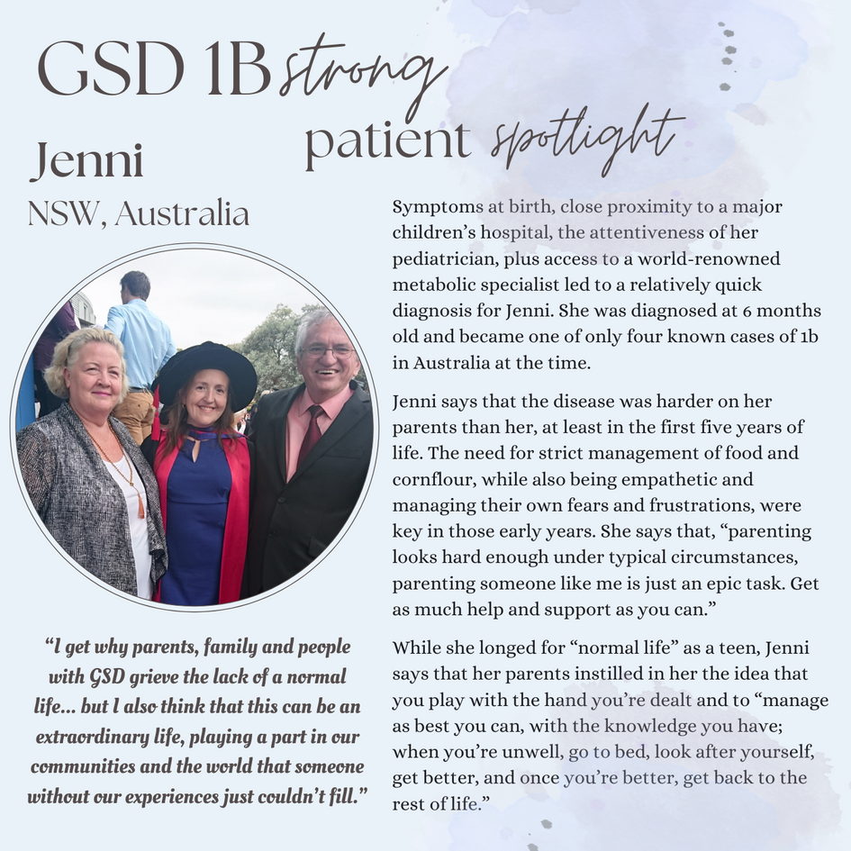
Direct Peer Support
Patient Spotlight Series
Notes:
Newly diagnosed outreach and patient materials.
Patient Spotlight series. Get the most hits and feedback on social media. Incredibly positive response and participation far beyond what we expected. Hear often how meaningful the stories are for other patients.
Also for researchers and industry-- face to the disease.
Empowers patients and caregivers to share their experience, can help others.

Slide 13





Thank you!
blair@sophieshopefoundation.org
@cure_gsd1b
cureGSD1b
Blair Stone-Schneider
Notes:
Symbolism of a bridge.
Thank you. Please find us on social media, reach out for more information.
Stickers and cards

Slide 14
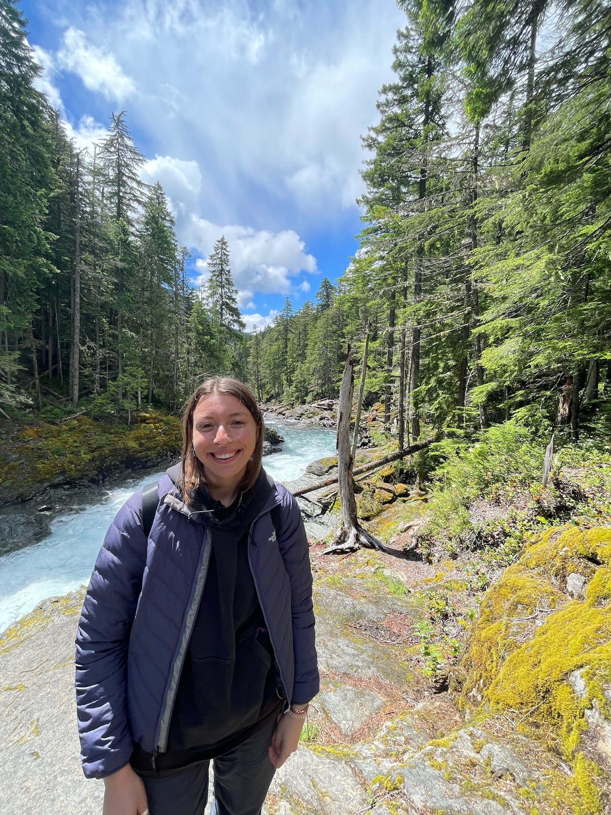
Naomi Abrahams - The Choice Research Lab

Slide 15
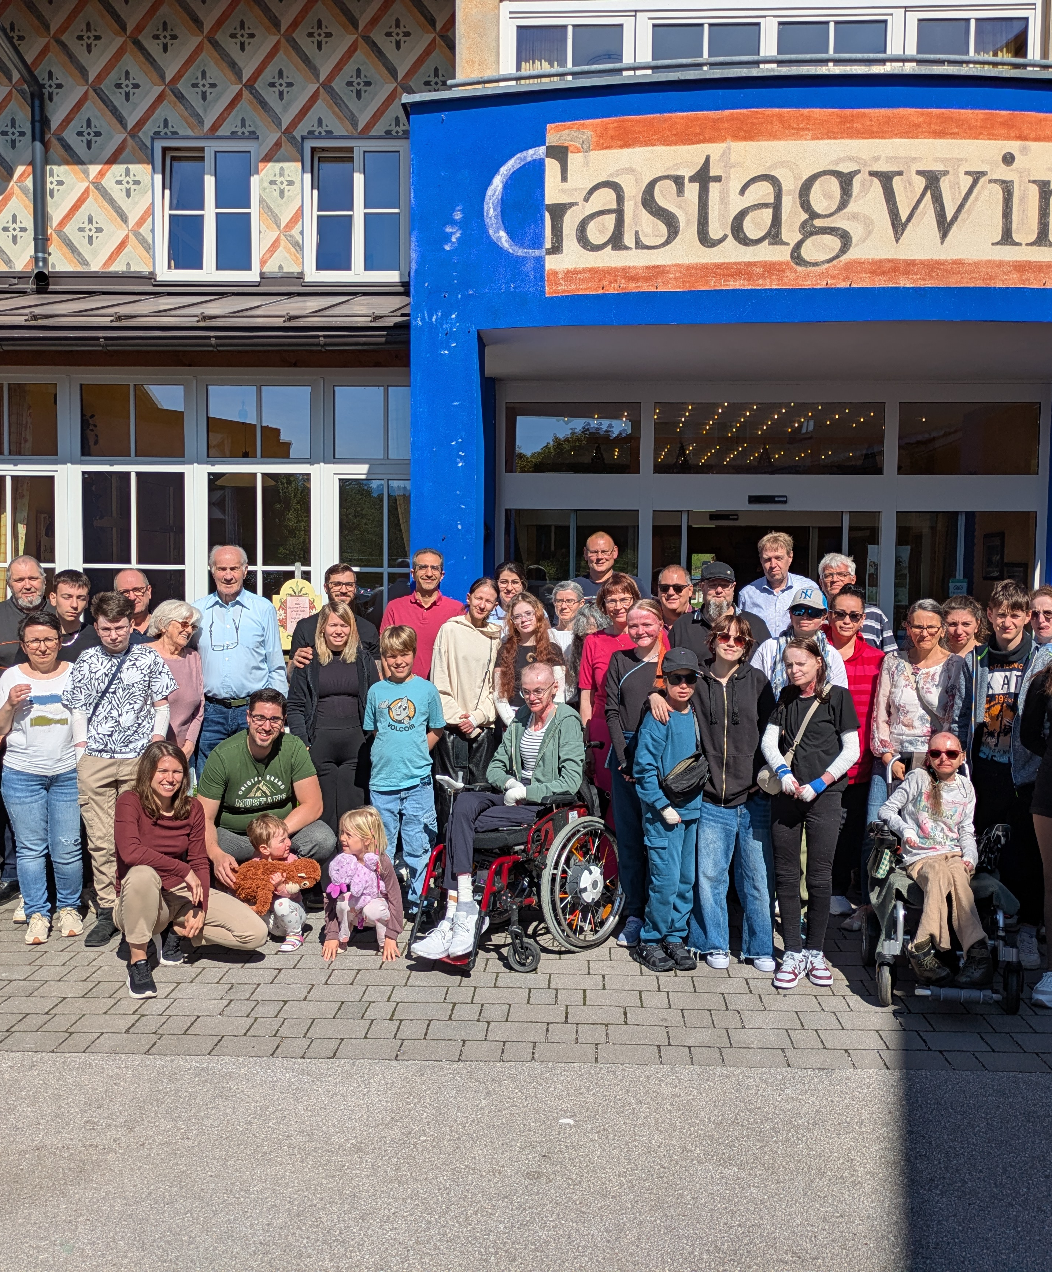
Melanie Isele - DEBRA Austria

Slide 16
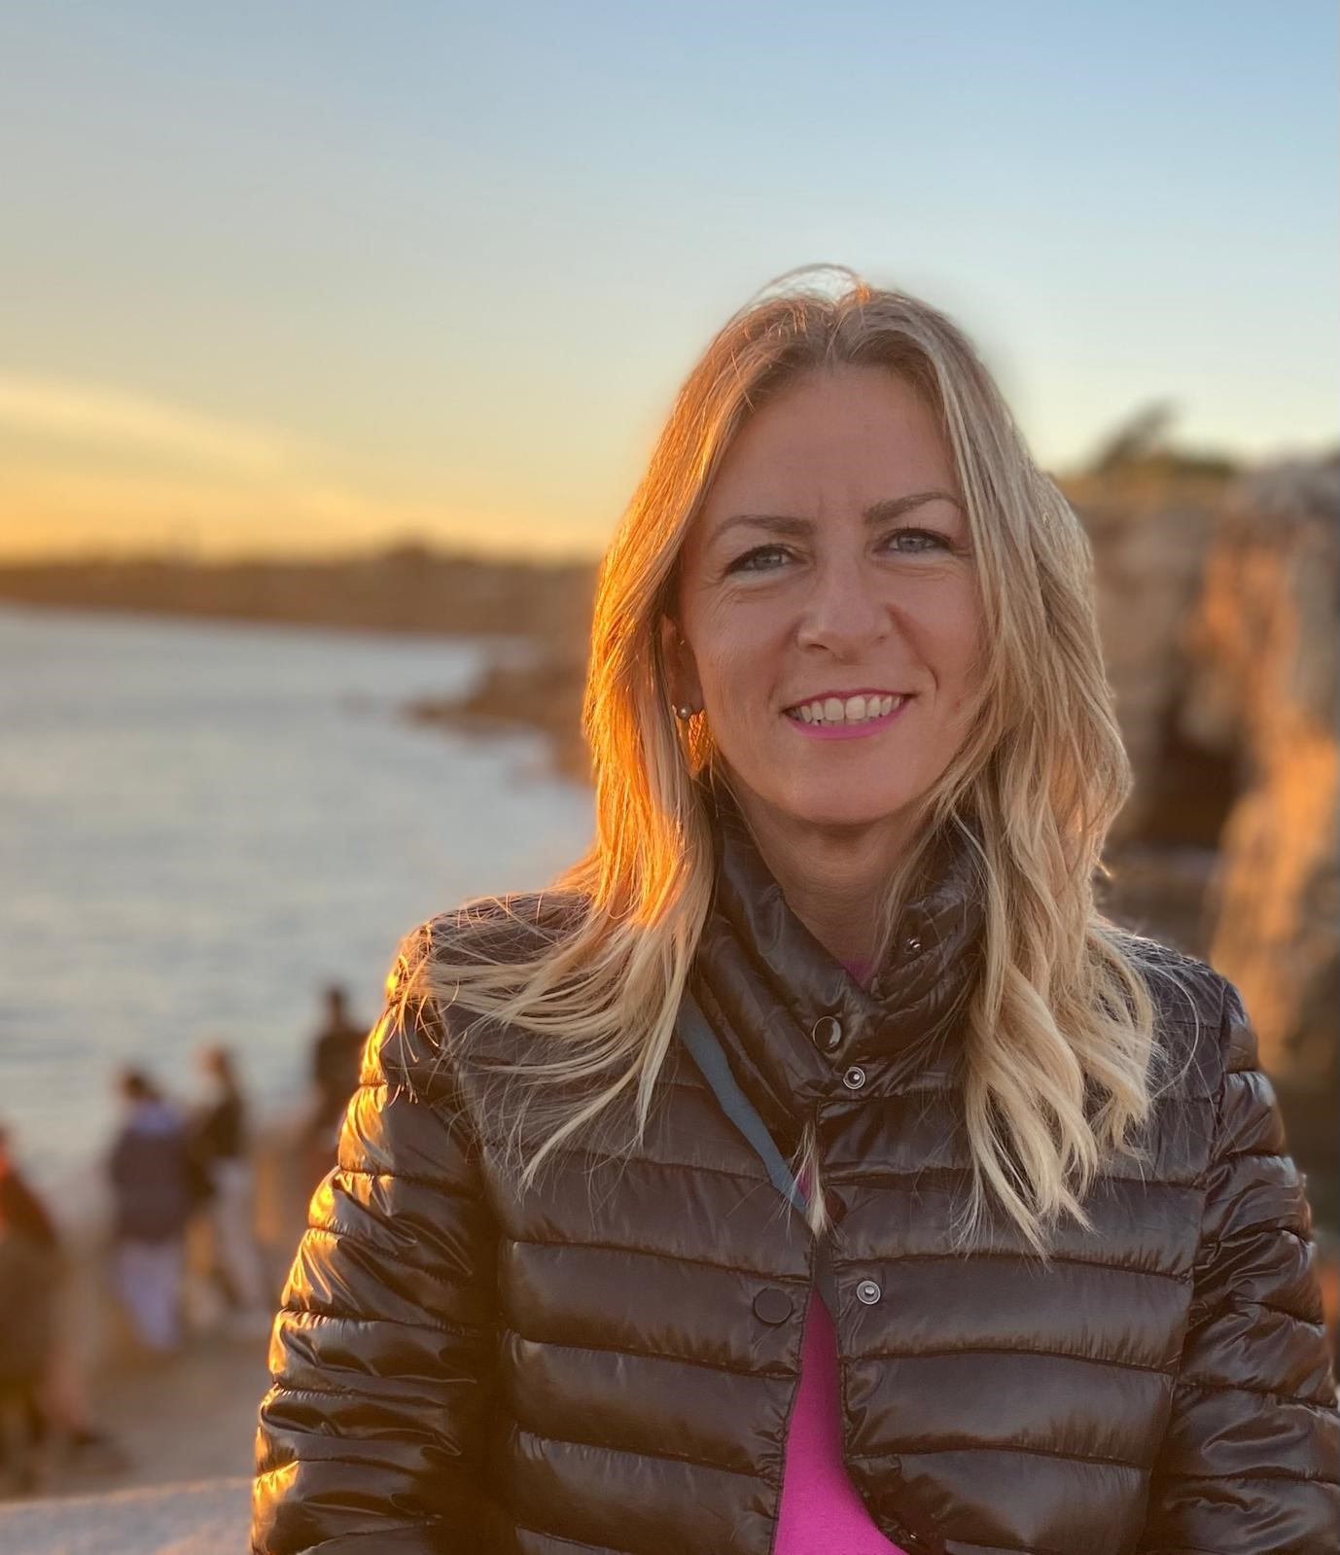
Giulia di Santis – HHT ITALIA Aps

Slide 17




HHT AND ME
the story of patient involved at 360° in HHT

Slide 18


From
evidence
to strategy
Giulia De Santis

Slide 19




HHT IN NUMBERS
PREVALENCE
DIAGNOISED
1:5000
Only 10% of those affected have a diagnosis.
~12.000
PEOPLE AFFECTED IN ITALY
www.hhtonlus.org
EURORDIS - SCHOOL OF SCIENTIFIC INNOVATION AND TRASLATIONAL RESEARCH

Slide 20


THE SURVEY
The diagnosis odyssey of people living with a rare disease
www.hhtonlus.org
EURORDIS - SCHOOL OF SCIENTIFIC INNOVATION AND TRASLATIONAL RESEARCH

Slide 21




THE PROCESS
networking
project membership
patients’ involvement
analysis of results
connection with other institutions and organizations
sharing the objective of the survey
engagement activities
Individual study and subsequent discussion of data
www.hhtonlus.org
EURORDIS - SCHOOL OF SCIENTIFIC INNOVATION AND TRASLATIONAL RESEARCH

Slide 22





THE PROCESS
HHT ITALA website
458
RESPONDENTS
IN EUROPE
social media
145
patients’ involvement
centers
RESPONDENTS
IN ITALY
channels for engagement activities
regional groups
of volunteers
www.hhtonlus.org
EURORDIS - SCHOOL OF SCIENTIFIC INNOVATION AND TRASLATIONAL RESEARCH

Slide 23

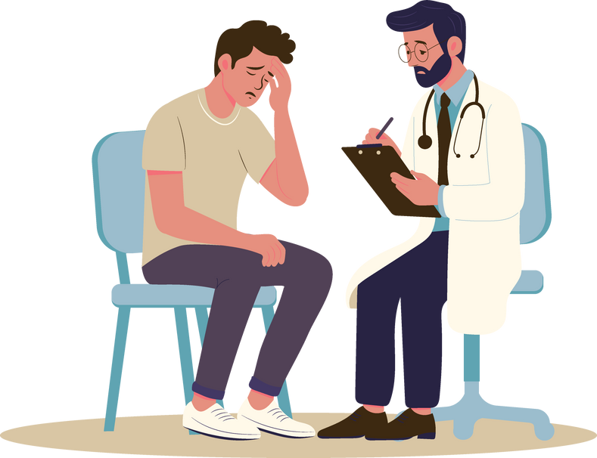

DATA ANALYSIS
The methodology and two main indicatrors
RTL
DTL
COMPARISON OF DATA
Referral Time Lag (time between referral to a physician and HHT onset)
Diagnosis Time Lag (time between first definite HHT diagnosis and the tim of HHt onset
With an previous study from 2009
www.hhtonlus.org
EURORDIS - SCHOOL OF SCIENTIFIC INNOVATION AND TRASLATIONAL RESEARCH

Slide 24

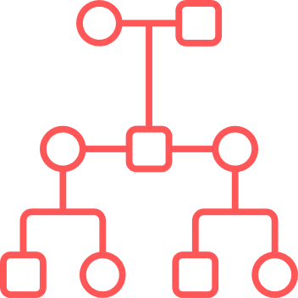



How to use the results?
FACTORS INFLUENCING DIAGNOSIS
INDEX STATUS
In 2000-2009
RTL 14.9 years
DTL 25.7 years
AGE AT ONSETOF SYMTPOMS
In 2020
RTL 2.3 years
DTL 7.8 years
GENDER
www.hhtonlus.org
EURORDIS - SCHOOL OF SCIENTIFIC INNOVATION AND TRASLATIONAL RESEARCH

Slide 25
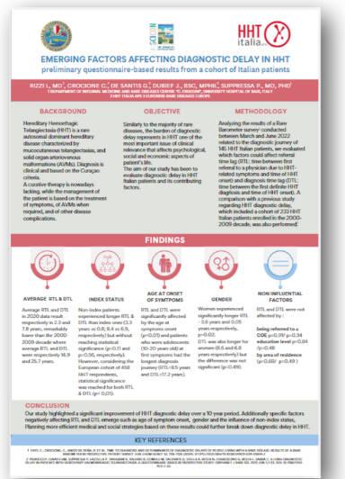
How to use the results?
Scientific poster
“Emerging factors affecting diagnostic dalay in HHT”
15Th HHT International Scientific Conference
October 2024
www.hhtonlus.org
EURORDIS - SCHOOL OF SCIENTIFIC INNOVATION AND TRASLATIONAL RESEARCH

Slide 26

How to use the results?
Strategic plan
DIAGNOSIS
more focused actions
ACTIONS 2025-2027
  pediatrics training
  new pediatric Centers
  gender GAP project
  newly diagnosed
support
ACTIONS 2012-2024
  information campaigns
  leaflets
  training
  press releases
www.hhtonlus.org
EURORDIS - SCHOOL OF SCIENTIFIC INNOVATION AND TRASLATIONAL RESEARCH

Slide 27
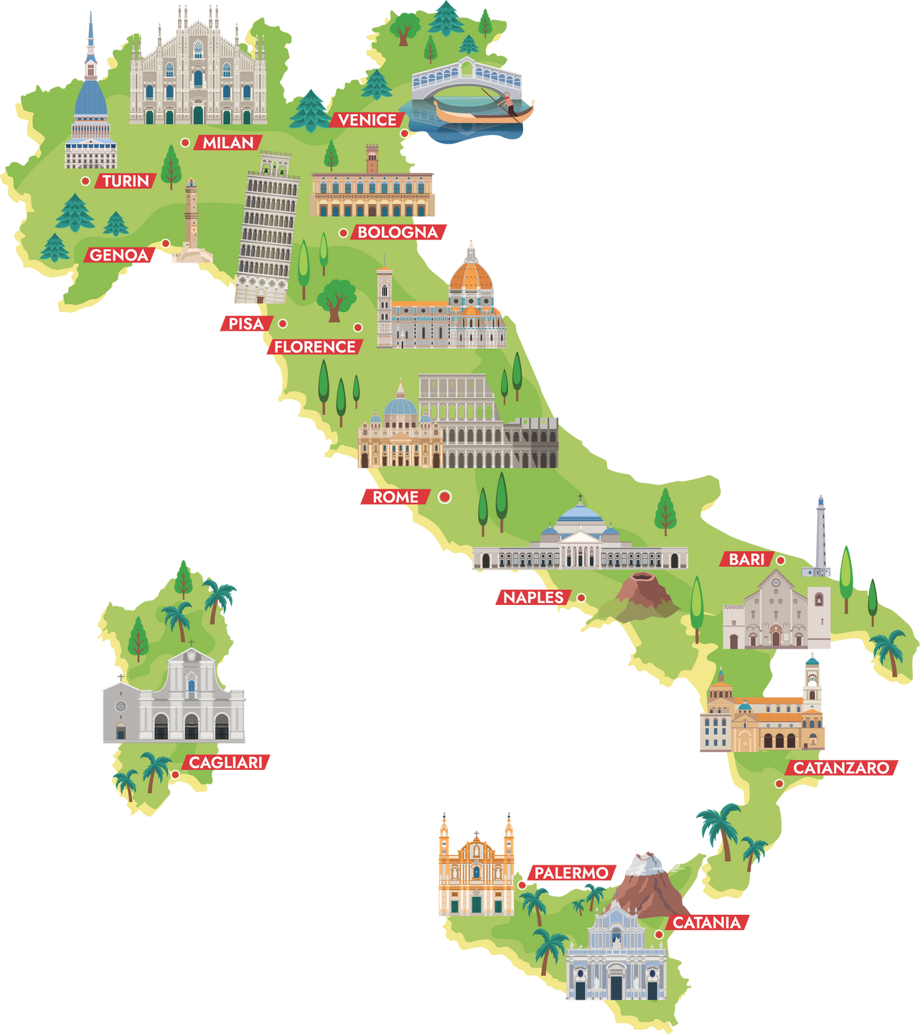
THANK YOU
AND GREETINGS FROM A TYPICAL ITALIAN

Slide 28
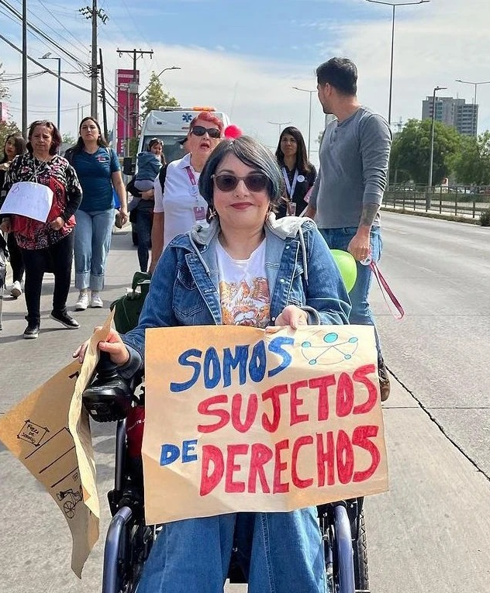
Christhyl Ceriche - Dimus Chile

