Slide 1
Ethical challenges &
patient perspective in
predictive analytics
Alexandros Nousias, Research Associate
NCSR Demokritos

Slide 2

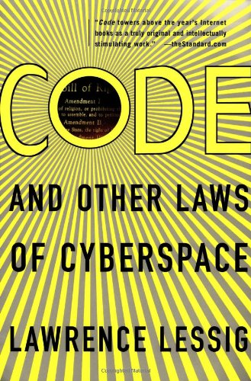
Code: And Other Laws Of
Cyberspace
(1999, 2006)
Lawrence Lessig.
“We can -we must- choose
what kind of cyberspace we
want and what freedoms we will guarantee. These choices are
all about architecture: about
what kind of code will govern
cyberspace, and who will
control it. In this realm, code is
the most significant form of law, and it is up to lawyers,
policymakers, and especially
citizens to decide what values
that code embodies”
From Code is Law
to Code as Law

Slide 3



4 Modalities of Regulation
Market
Law
Code
Norms
You

Slide 4


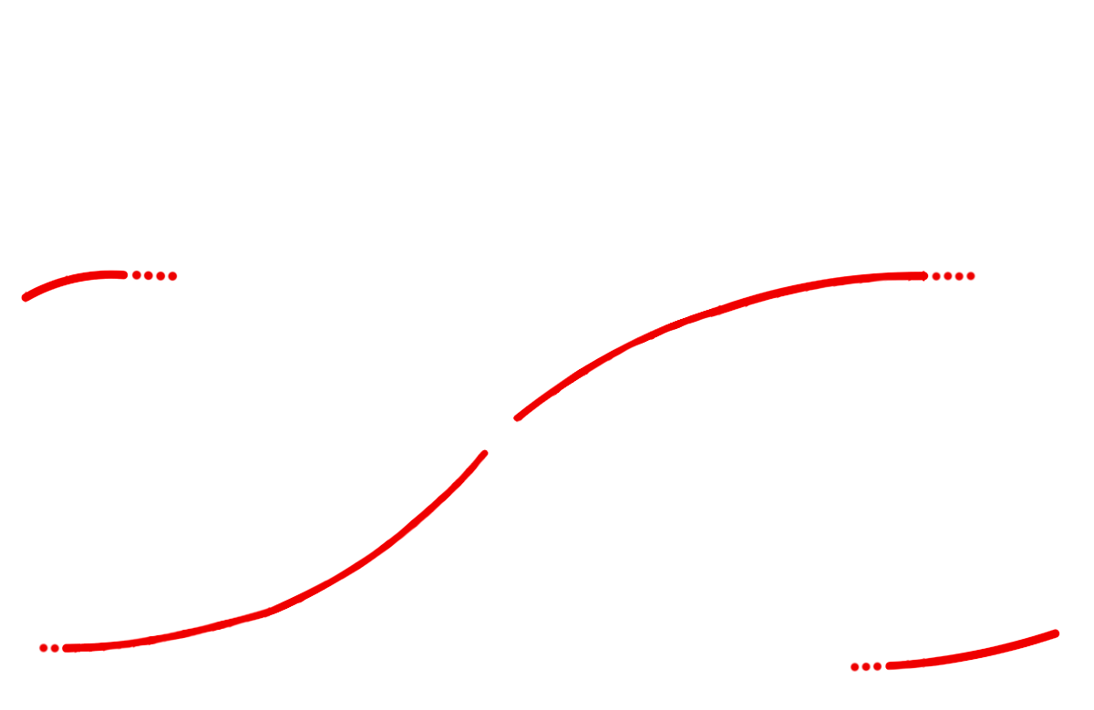
The techno-economic paradigm (TEP)
TEP is a recurring pattern of cyclical movement: from an initial installation period, through a collapse and recession which signify the turning point, to a full deployment period.
Turning Point
Degree
of diffusion
of the
technological
revolution
Previous Great Surge
Maturity
Synergy
Frenzy
Irruption
Next Great Surge
Time
Installation Period
Deployment Period
© Carlota Perez: The techno-economic paradigm shift

Slide 5
The real question
Technology
Problem
What technology do you want to use? vs. What problem do you want to solve?
What problem do you create?

Slide 6
DIKW pyramid
"Typically information is defined in terms of data, knowledge in terms of information, and wisdom in terms of knowledge"
WISDOM
applied knowledge
DATA
abstracted elements
WORLD
KNOWLEDGE
organized information
INFORMATION
linked elements

Slide 7
Data science pyramid
Hierarchy of data science activity
Decision
Making
Data Aggregating
Preprocessing and Warehousing
Data Sources
Transactional, operational, social, environmental, etc.
Machine Learning
Data Exploration
Increasing potential
to support
business decisions

Slide 8
What is digital ethics about?
Definition of Digital Ethics
Branch of ethics that studies and evaluates moral problems relating to data and information (like generation, recording curation, processing, dissemination, sharing, use) to algorithms (like AI, artificial agents, machine learning and robots) and corresponding practices and infrastructures (like responsible innovation, programming, hacking, professional
codes and standards).
Data and Information
Generation, recording, curation, processing, dissemination, sharing, use
Algorithms
AI, artificial agents, machine learning and robots
Practices and Infrastructures
Responsible innovation, programming, hacking, professional codes and standards

Slide 9
What is data ethics about?
A branch of ethics about moral problems related to data, algorithms and corresponding practices
1. Responsible and sustainable use of data
2. Doing the right thing for people and society
3. Adhere to principles on which human rights and personal data protection laws are based
4. Honest and genuine transparency in data management
5. Actively develop privacy by design
5. Actively develop AI ethics by design
6. Actively develop values based products and infrastructures
7. Treat others personal info as you wish for your self and your children

Slide 10
Code as Law
Market
Code as Law
Law
Code
Norms

Slide 11






What’s in common?
Surveillance
Scanning the complete human experience
Oil well
?
Pumps oil
Smart phone
Scans your microbiome data and tied to an AI app gives customized health actions and insights based on your Data
Smart toilet
Pumps
microbiome data

Slide 12

Data as an Infrastructure
Market
Insurance
App developers
Mobility service
Bank
Grocery/
Retail store
Researchers
Healthcare
Government
Web media
Employers
Electricity company
Relatives
Peer groups

Slide 13
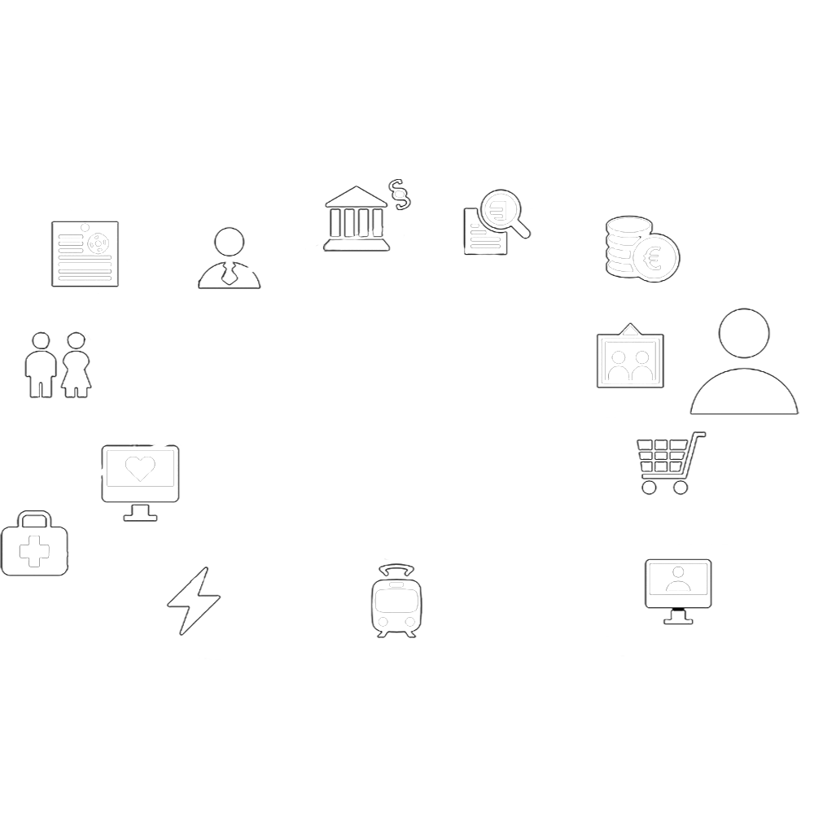
API ecosystem
In the current structureless API economy, if the number of services grow,
then the number of connections between them grow at a faster rate
Government
Researchers
Insurance
Employers
Bank
Peer groups
No infrastructure
Relatives
Web media
Grocery/
Retail store
Healthcare
Electricity company
App developers
Mobility service

Slide 14
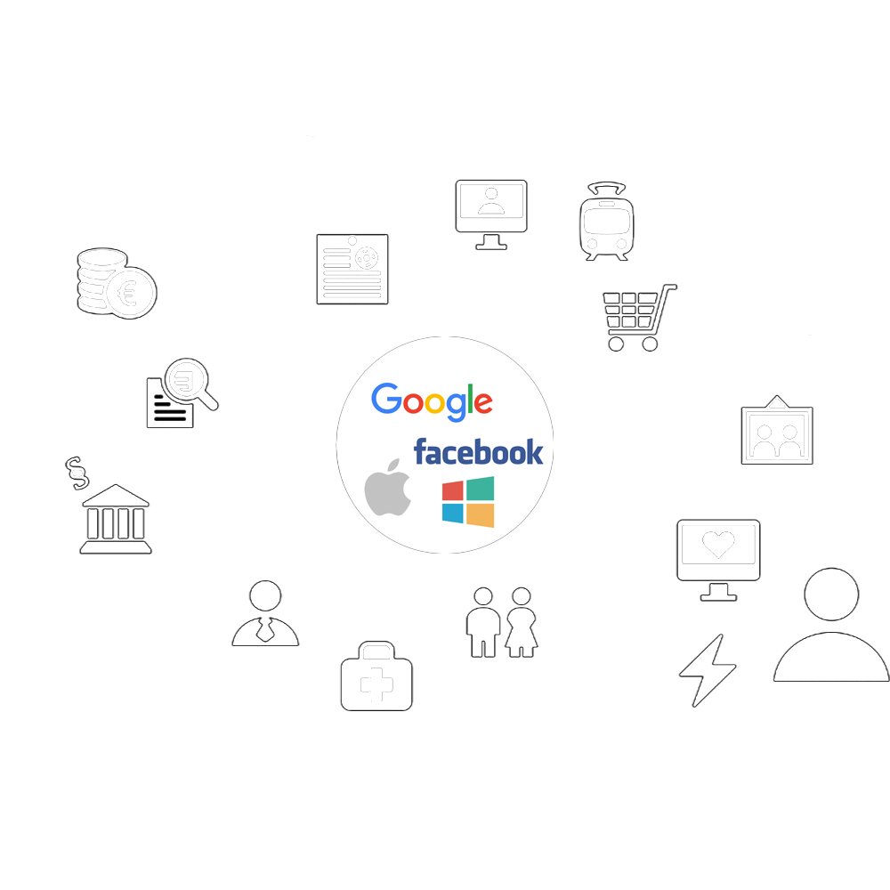
Aggregator Model
Aggregating data control is easier, but different aggregators do not have a built-in
incentive to develop interoperability between them
App developers
Mobility service
Insurance
Bank
Grocery/
Retail store
Researchers
Relatives
Government
Web media
Employers
Peer groups
Electricity company
Healthcare

Slide 15

The Paradigm of Now
User
Proxy
(data intermediary DGA art.9)
ToS and
Privacy Notice
Business A (data holder/user)
Business B (data holder/user)
B2B Data Flow

Slide 16

Personal data sovereignty (PDS)
PDS model is characterized by data subjects having greater control on their data, both in terms of
privacy management and data portability
Insurance
App developers
Mobility service
Bank
Grocery/
Retail store
MyData is a resilient system, not dependent on a single organization
or technical infrastructure
Researchers
Healthcare
Government
Web media
Employers
Electricity company
Relatives
Peer groups

Slide 17




(My health)Data Flows
MyData Operator
Consent Flow
Healthcare
Provider
Source A:
Tracing app
Data Flow
Money Flow
Source B:
Rare Disease Data Registry
Pharma R&D

Slide 18
Wide range of AI use cases in health
AI can play its role in all aspects of health services
AI/ML in health is making the world smarter for pharmacists, health care providers, and at last, end users.
Early diagnosis
& disease detection
Fraud
detection in prescription
Genomic analysis & variant interpretation
Automated
billing and reimbursement
AI in
Health
Clinical decision support systems
Stock management
Drug Discovery & repurposing
Patient empowerment & community insights

Slide 19
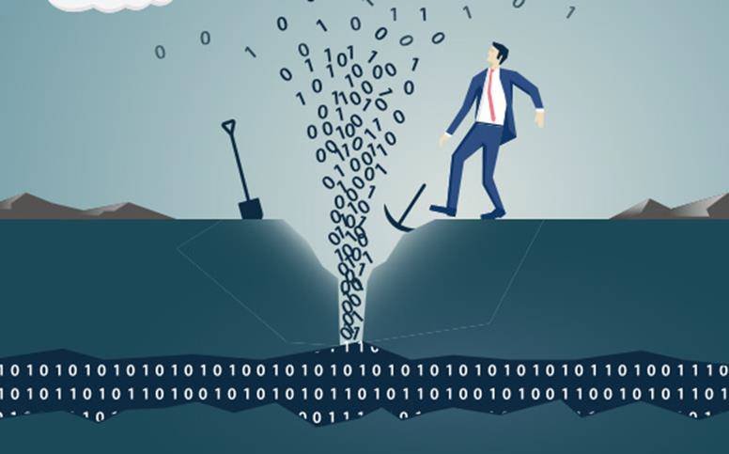

Data in AI health
Data is the new (s)oil?
Commercial
(pricing, insurance,
Offers)
Profile
(history & preferences)
Pharmaceutical
(dosage, side
effects)
Biomedical literature, CT databases
Medical & Clinical
(EHR, Lab)
Regulation & Protocols
Big data storage solution
Structured data
Semi-structured data
Unstructured data

Slide 20
Data in AI health
From descriptive to prescriptive data analytics
What
happened?
Why did it
happen?
What will
happen?
How do we
make it happen?
Value
Prescriptive
Analytics
Predictive
Analytics
Diagnostic
Analytics
Descriptive
Analytics
Decision focused
Information and insight focused
Difficulty/complexity

Slide 21
General vs. Personal AI
Delivering informed decisions
General AI
Personal AI
Ask about
public data
Ask about personal
and/or public data
+
Public
Data
Personal
Data
Public
Data
Replies based on
public data
Replies based on
personal data
Can reply from public data based on personal
data enabled queries or filtering

Slide 22
Trade-offs
Data
Data others keep about you
Value that you gain from it

Slide 23


Can we ask ChatGPT?
ChatGPT

Slide 24

a dialog..
Medication interaction inquiry
Hey AI! I have a patient taking atorvastatin and clarithromycin. Should I be worried?
Yes this interaction can elevate the risk of muscle pain. Consider switching to an alternative statin like rosuvastatin
Thank you! I think I got this ☺

Slide 25
a dialog..
Patient education material
Hey AI! I often run out of common pain relievers during flu season. I need to optimize my inventory management
Here is a template for monitoring sales trends. Use columns for: product name, daily sales, stock on hand, reorder level, 30 day demand forecast
Thank you! Will do ☺

Slide 26
Trade-offs
Algorithms
Algorithmic performance
Task optimization & impact

Slide 27
Cognitive Biases
Which biases should you pay particular attention to when developing AI based systems
Facts &
Evidence
Our
Beliefs

Slide 28
Cognitive Biases
Confirmation Bias
This is the tendency to seek, interpret, and remember information that confirms pre-existing beliefs. In AI, this might lead to a model being trained on data that reinforces the biases of its developers or the data source rather than representing a balanced perspective.
Facts &
Evidence
Evidence
we Believe
Our
Beliefs

Slide 29
Cognitive Biases
Algorithmic Bias
This refers to biases that arise from the algorithms themselves, including how data are collected, coded, selected, or used in training. Algorithms can perpetuate or amplify societal and cultural biases if not carefully monitored and corrected.
Input
Algorithms
Users
Output

Slide 30



The Logic of Information
Why a ML model gives a certain output? Logic of design as a logic of requirements
{R1...Rn} = System
Chair for one person
Stool
Identify the requirements of a system and how these requirements ‘sufficientize’ our solution:
Context
Level of Abstraction
Purpose
Retro
Electric chair

Slide 31
Predictive analytics in health
Linear understanding of life
A human constructed forecasting tool designed to
reduce uncertainty
Early diagnosis
Affects patients rights
(stigma, anxiety)
Personalised care
Denies the role of chance
AI in
Health
Informed desicions
Undermining autonomy
Access to targeted health interventions
Guide preparations for future scenarios

Slide 32
Trade-offs
Predictive Analytics
Overreliance to AIS
Value that you gain from it

Slide 33
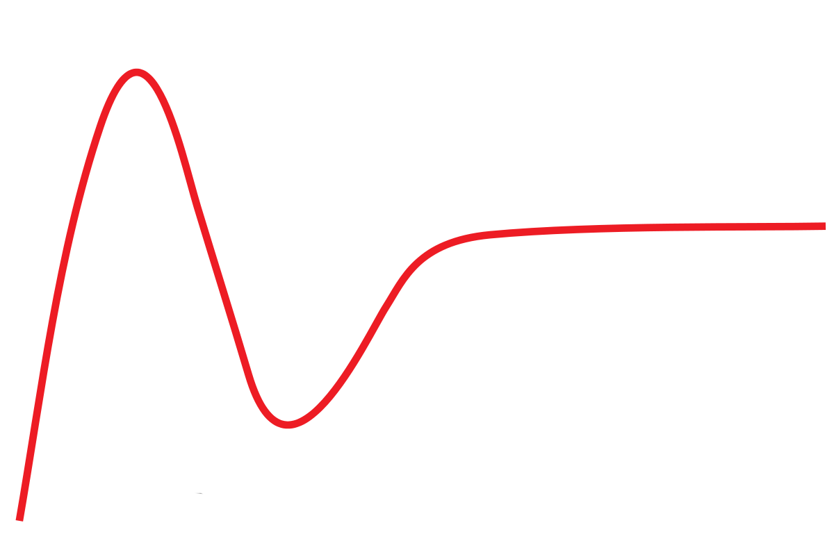


Amara's law
It takes a lot of time to apply knowledge in a productive way, beyond the initial hype
Visibility
Hype
AI literacy & applied knowledge
Time

Slide 34
Thank You
Alexandros Nousias

Slide 35



Alexandros Nousias
@alexnousias
https://www.linkedin.com/in/alexandrosnoussias/
alexandros.nousias@gmail.com

