Slide 1
Advocacy Context + EU Pharmaceutical Legislation
14 May 2025
Open Academy - Webinar n°4
Virginie Hivert & Rosa Castro, EURORDIS-Rare Diseases Europe
Notes:
Virginie

Slide 2
Let's start with a quiz about the EU !!!
Notes:
Rosa

Slide 3
EU Institutions
The European Commission is the executive branch of the European Union responsible for proposing legislations, implementing decisions, and upholding EU treaties.
The European Parliament is the directly elected legislative body of the European Union, representing the interests of EU citizens and participating in the legislative process alongside the Council of the European Union (co-legislator). Since the EU elections last year (June 2024), the Parliament is composed of 720 MEPs.
The Council of the EU is the institution representing the 27 member states and participating in the legislative process alongside the EU Parliament (co-legislator).
Notes:
Rosa

Slide 4
Knowing about the EU legislation journey
Notes:
Rosa

Slide 5
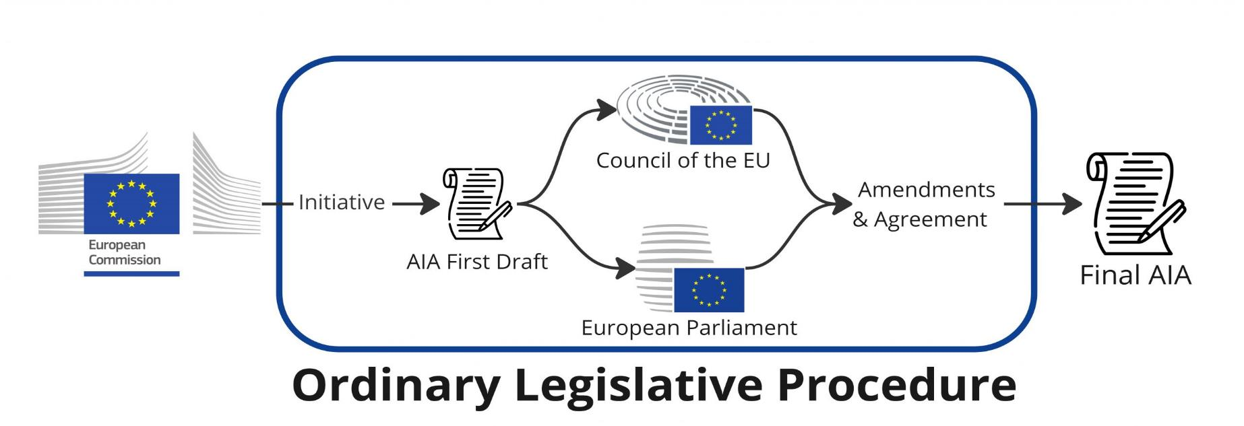
The EU Legislation Journey
All these stages are important for our advocacy work - the aim is to ensure that our voice is heard by the EU institutions at every stage of the EU legislative process and to convince the two co-legislators to supports OUR amendments.
Final EU text
The special legislative procedure means that the Council is the only legislator, instead of being co-legislator on equal footing (co-decision) with the European Parliament (e.g. serious breach of fundamental rights, accession of new EU members, international agreements.
Notes:
Rosa

Slide 6
The EU
Pharmaceutical Legislation
Notes:
Virginie

Slide 7
Let’s get started …
How many therapies have we got approved in Europe since 2000?
How many diseases / conditions have been targeted?
How many patients have potentially benefitted from OMPs authorised in Europe?
Notes:
Virginie

Slide 8
Let’s open mentimeter again
Notes:
Virginie

Slide 9
Question n. 1
Notes:
Virginie

Slide 10
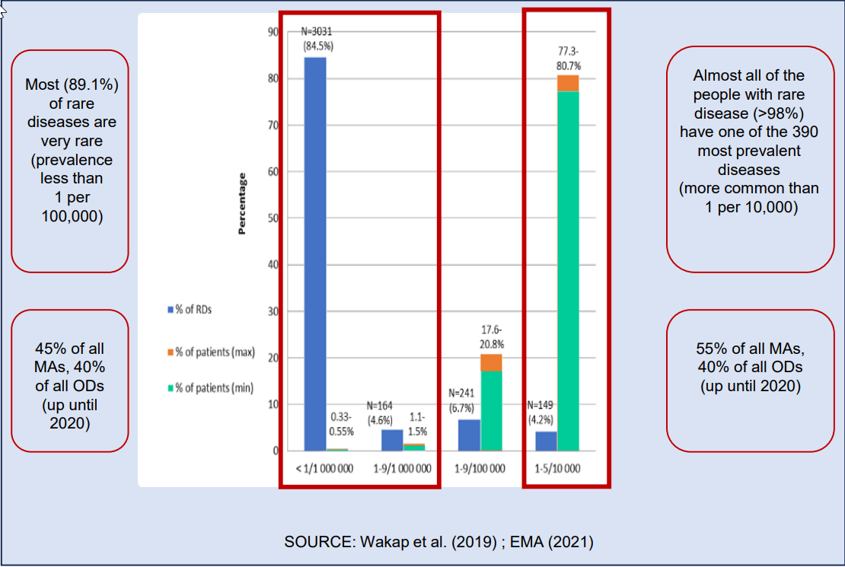
Question n. 2
https://ojrd.biomedcentral.com/articles/10.1186/s13023-024-03095-z
Notes:
Virginie

Slide 11
Question n. 3
“By the end of 2017, 142 orphan medicines had been authorised. These cover a wide range of conditions and indications, including many very rare diseases. Based on estimates of disease prevalence and the population size in the EU, it is estimated that a maximum of 6.3 million people stand to benefit from these treatments. In reality, though, orphan medicines target sub-sets of such patients, based on factors such as disease stage and severity, age, or presence of certain gene mutations. Therefore, the actual treatment population of patients at any time is only a portion of this.”
https://health.ec.europa.eu/system/files/2020-08/orphan-regulation_study_final-report_en_0.pdf
Notes:
Virginie

Slide 12
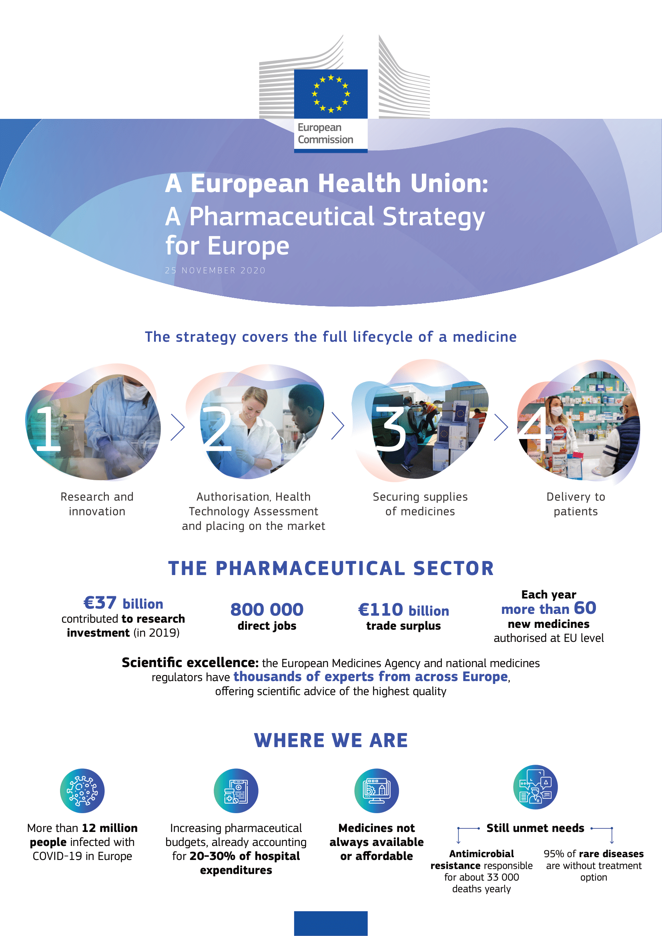
What are we talking about
More than 50 different legislative and non-legislative actions are proposed
Review of:
The 2001 Pharmaceutical Directive (2001/83)
The 2004 EMA Regulation (746/2004)
The 2000 Orphan Drugs Regulation (141/2000)
The 2006 Paediatric Regulation (1901/2006)
Notes:
Virginie

Slide 13
TIMELINE OF THE EU GPL until 29 April 2024
November 2022 – EURORDIS’s position on the revision of the OMP regulation.
04 - 05 October – Draft report of MEP Weiss (EPP, Denmark) for the Directive and MEP Wölken (S&D, Germany) for the Regulation.
13 -14 November – Deadline for tabling amendments at the ENVI Committee
10 April – Vote in Plenary session – successful and adoption of the final position of the EP
June 2025 – XX 2026 – Trilogues
April – June 2024 – Discussions in the Council on shortages and beginning of the Chapter focusing on incentives (BE Presidency followed up by Hungarian & Polish Presidency)
19 March – Vote in the ENVI Committee on the compromise amendments – Successful vote and text to go to plenary session
2027 – 2028 Implementation of the EU GPL
26 April 2023– European Commission’s proposal published
24 October – European Commission’s communication on drug shortages
Notes:
Virginie

Slide 14
1 - The Commission’s proposal 26 April 2023
Notes:
Virginie

Slide 15
In a nutshell – key changes introduced
All in one regulation and one directive:
Laying down Union procedures for the authorisation and supervision of medicinal products for human use and establishing rules governing the European Medicines Agency (‘The Regulation’)
Union code relating to medicinal products for human use (‘the Directive’)
Introduction of the concept of Unmet Medical Need / High Unmet Medical Need
Modulation of incentives & conditionalities linked to access
Radical changes in the EMA structure, codification of PRIME & shortening assessment times
Addressing shortages, AMR and environmental impact
Patient representation at CHMP & consultation on guidelines
Notes:
Virginie

Slide 16
Final EP Position – 10 April 2024
Notes:
Rosa

Slide 17
Final EP position Some considerations
Priority for compromises due to future issues (far rights political groups likely to gain power / less interested in European cooperation, etc.)
Negociations extremely difficult between the different political groups and the rapporteurs.
Negotiations concluded at the very last minute
Tight deadlines and lack of time for discussion (more than 3000 amendments).
Notes:
Rosa

Slide 18
Key elements included thanks to our advocacy
Introducing (voluntary) centralised procurement for centrally authorized
Ensuring the codification of PRIME scheme and supporting improved access to OMPs
Allowing the right format for early dialogues
Adoption of a ‘European Framework for Rare Diseases’
The right modulation of incentives for market exclusivity
Introduction of a modulated system to provide tailored levels of incentives depending on different factors to best address the unmet needs of people living with a rare disease.
To enhance negotiation capabilities, striving for equitable prices through collective bargaining, thereby fortifying healthcare systems, especially for smaller member states and for treatment of the lowest prevalence diseases.
Accelerated approval and enhanced regulatory support are essential to bring innovation to patients as early as possible, when a medicine is transformative, or potentially curative, in areas of unmet needs.
Early dialogue between stakeholders is
crucial for the effective development
and success of rare orphan drugs.
To ensure that critical pieces of legislation work effectively together in the building
of the European Health Union. Also called ‘EU Action Plan on Rare Diseases’.
Notes:
Rosa

Slide 19
Following Steps
May – September
EU election periods
The Council has then started to work on the dossier and establish its positions.
The EP is no longer working on any dossiers. As far as the pharmaceutical legislation is concerned, the new Parliament took over after the European elections on June 6-9.
September 2024 / 2027
Ongoing negotiations and adoption
Negotiations between co-legislators resume with a newly elected European Parliament.
Unlikely that the proposed legislation will be adopted before 2025 or 2026.
Becoming applicable possibly after 2027.
Notes:
Rosa

Slide 20
EURORDIS’s actions and tasks
Follow developments in the Council on this file
Organise meetings with Health Attachés in Brussels
Gather information from NAs (debate in national parliaments, press articles, meetings of Nas with ministries of health, etc )
Continue to share EURORDIS’s position
Monitor potential (new) MEPs who can support our position in the newly elected EP
May – September
EU election periods
The Council has then started to work on the dossier and establish its positions.
The EP is no longer working on any dossiers. As far as the pharmaceutical legislation is concerned, the new Parliament took over after the European elections on June 6-9.
Notes:
Rosa

Slide 21
Next Steps EURORDIS’s actions and tasks
Follow-up with the Council and the EP
Monitoring the negotiations (trilogues)
Continue to communicate EURORDIS’s positions / amendments
Report back to our members
June 2024 / 2027
Ongoing negociations and adoption
Negotiations between co-legislators resume with a newly elected European Parliament.
Unlikely that the proposed legislation will be adopted before 2025 or 2026.
Becoming applicable possibly after 2027.
Notes:
Rosa

Slide 22
Joint Statement with EPF – European Patients Forum
https://www.eurordis.org/epf-eurordis-joint-statement-patient-involvement/
Notes:
Rosa

Slide 23
Any questions
?

Slide 24
Pre-training check-in & next steps
Go to Menti!
Notes:
Solène

Slide 25
Pre-training check-in & next steps
https://openacademy.eurordis.org/mrd25/
Notes:
Solène

Slide 26
Pre-training check-in & next steps
Notes:
Solène

