Slide 1
Making Europe a world-leader in rare diseases research and innovation
Data initiatives driven for and by the patients
Elvina Sakellariou, Duchenne Data Foundation

Slide 2
Table of Contents
DDF vision and mission
Duchenne Data Repository overview
Demo
Duchenne Map overview
Demo
Q&A

Slide 3
Our vision
To bring data to life for the benefit of people living with dystrophinopathies
Our principles
Equal and easy access to data for all
Open access to data analysis results
Data use and re-use to advance research and drug development
Open-source tools for research
Patient data ownership

Slide 4
Duchenne Data Repository A global hub for DMD/BMD data

Slide 5
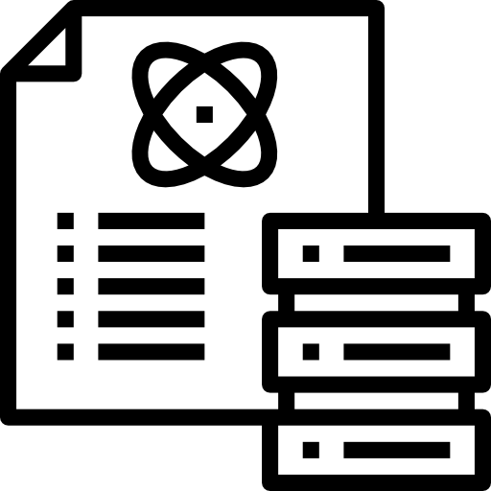
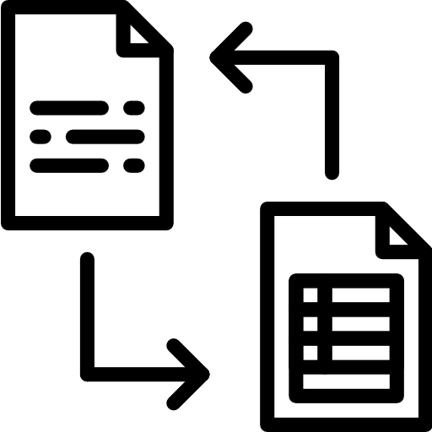
Duchenne Data Repository: Aims
Realize collection & connection of data/metadata from different sources
Enable discovery of data/metadata (Findable) & access to it (Accesible)
Facilitate sharing (Interoperable) & use (Reusable) of data/metadata
Improve care and accelerate discovery of effective treatments

Slide 6
Duchenne Data Repository: Characteristics
Focus on data for dystrophinopathy data (various types)
Open-source code
FAIR-by-design
Standard metadata schema following Dublin Core's Metadata Outline
Automated metadata export scripts to FAIR Data Point
Standardization of data collection, sharing & publication
Development of an Information Security Management System Manual
Data Governance Management System in place
Sustainable and under verification process (e.g. ISO 27001)

Slide 7
Duchenne Data Repository: Infrastructure
Data Input
Storage/ Collaborative workspace
FAIR-ification
Public Site
Clinical Trials
DDF FAIR Data Point
ONTOLOGIES
Raw Data
EU-funded Projects
CLINICAL DATA
Processed Data
Duchenne
Data Repository
DDF Graph DB
Metadata
CORE DATA ELEMENTS
External Databases
AI-based analytical tools
PRECLINICAL DATA

Slide 8
Duchenne Data Repository: Associated projects

Slide 9
DEMO

Slide 10
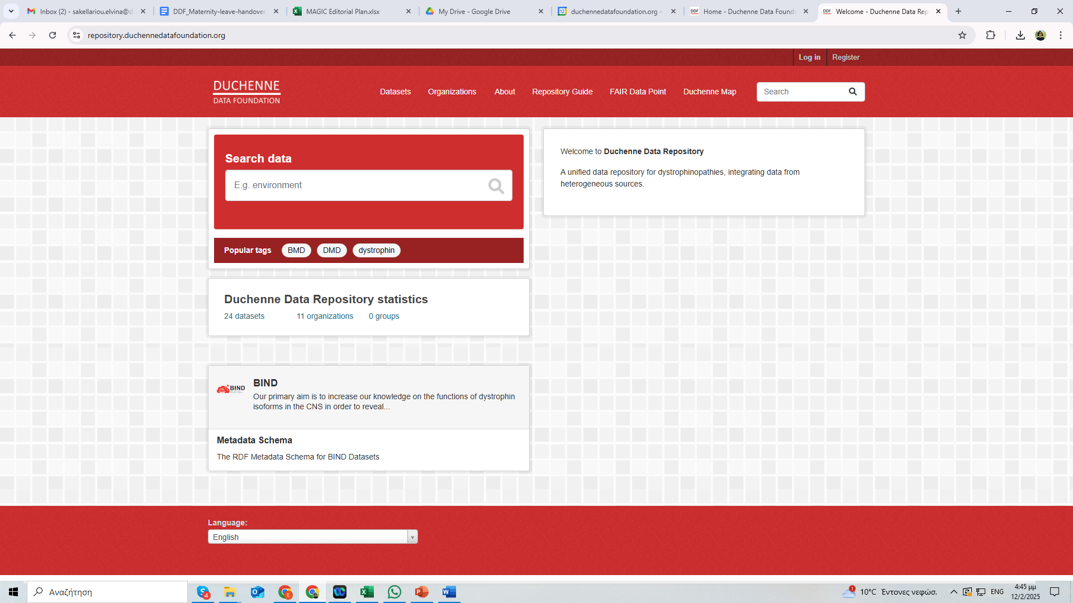
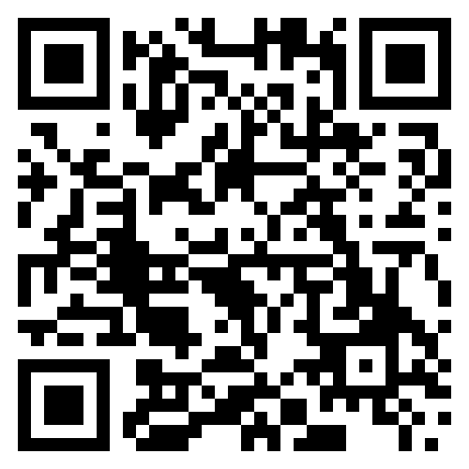
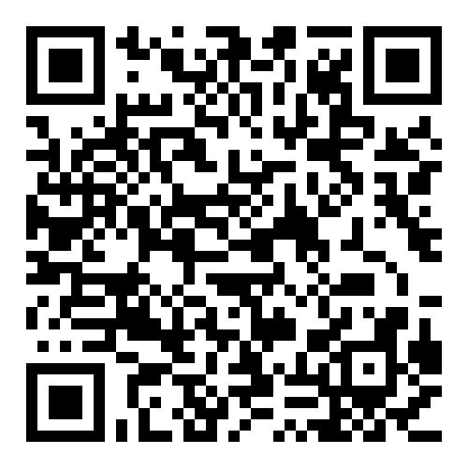
Duchenne Data Repository
Home page
User registration
https://repository.duchennedatafoundation.org/

Slide 11
Duchenne Map One place for all information about DMD/BMD

Slide 12
Duchenne Map
Αn online platform centralizing important information
A hub to bring closer patients and their families with community stakeholders at a global level
Leveraged for a variety of uses that will add value to care, research and therapy development and care

Slide 13
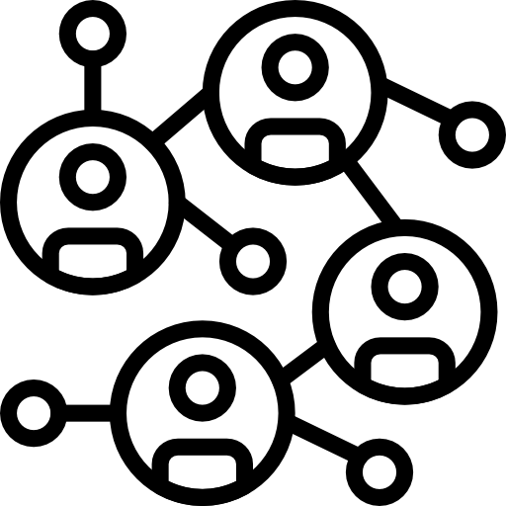
Features
connect
understand
Contribute
Engage and connect with the local and global DMD/BMD community to advance development in healthcare.
Develop a deeper understanding of the Duchenne & Becker muscular dystrophy field.
Contribute to the collection of validated information to promote Duchenne healthcare.
access
credible
community
Find practical information about support, care, and information, help identify and contribute to research projects.
In Duchenne Map, all information is verified and guaranteed up-to-date.
Be visible in the global DMD/BMD community, share knowledge and connect with peers and stakeholders.

Slide 14
How it works
1
2
3
4
Registration
Verification &
Validation
User profile completion
Access to Duchenne Map
Users register following a simple & quick registration procedure
Machine & human validation process assures the accuracy of users’ information
Users gain access to the Map & complete their profile with detailed information
Different levels of information will be visible for different users.

Slide 15
Accessible Information
Users of the Duchenne Map can find information about dystrophinopathies in terms of:
Support
Clinical Trial Sites
Care
Research
Patient Organizations
Companies
Care Centers
Care Centers
Healthcare Professionals
Research Institutes
Researchers

Slide 16
Current Status
USERS
FUNCTIONALITIES
Clinical Trial Site filter based on age, use of corticosteroids & ambulation status
Clinical Trial Site filter based on the mutation type is under development
Patient Organizations (30)
Clinical Trial Sites (65)

Slide 17
DEMO

Slide 18
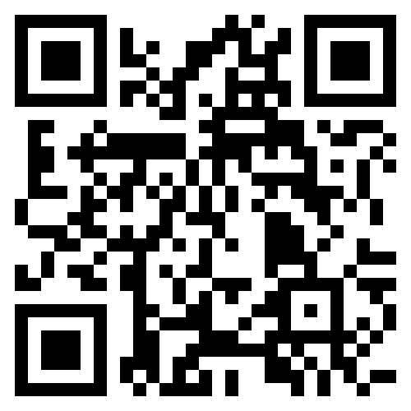
Duchenne Map
Home page
https://duchenne-map.web.app/

Slide 19
Collaboration Opportunities
Provide support for the development:
Disease-specific database
Disease-specific CT navigator tool
Other patient-centered applications

Slide 20
Q & A session

Slide 21
Thank you!
For inquiries please contact:
Elvina Sakellariou sakellariou.elvina@duchennedatafoundation.org
Sergiu Siminiuc sergiu@duchennedatafoundation.org

