Slide 1
Introduction to Data and Data Types: A Patient-Centric Perspective
Holm Graessner, 14/02/2025

Slide 2

Table of Contents
What is Data?
How is Data Collected in Healthcare?
Use of Data in Clinical Settings
Use of Data in Research
Structured vs. Unstructured Data
Red Flags in Data Collection
Genetic Data
Real-World Data
Artificial Intelligence
Data Protection and Privacy

Slide 3
What is Data?
Definition: Data are facts, figures, or information collected for analysis.
Types of Data in Healthcare:
  Patient demographics (age, gender, etc.)
  Medical history
  Test results
  Doctor's notes
  Imaging (X-rays, MRIs)
  Genetic data

Slide 4
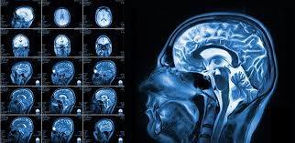
How is Data Collected in Healthcare?
Sources of Clinical Data:
  Direct Patient Interaction: Consultations, surveys, interviews
  Medical Devices: Heart rate monitors, glucose meters
  Electronic Health Records (EHRs): Digital patient files
  Laboratory Tests & Imaging: Blood tests, MRI scans

Slide 5
Use of Data
Use of Data in Clinical Contexts
Use of Data in Research Contexts
Purpose: To improve patient care and support clinical decisions
Applications:
  Diagnosing conditions
  Monitoring treatment effectiveness
  Managing chronic diseases
Example: EHRs help doctors track patient history over time
Purpose: To advance medical knowledge and improve healthcare outcomes
Types of Research:
  Clinical trials
  Epidemiological studies
  Health services research
Data Use: Identifying trends, testing hypotheses, developing new treatments

Slide 6
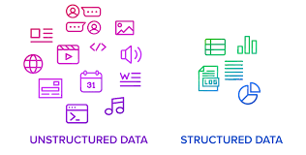
Structured vs. Unstructured Data
Structured Data: Organized, easy to search (e.g., lab results, vital signs)
Unstructured Data: Free-text format, harder to analyze (e.g., doctor’s notes, images)
Key Differences:
  Storage: Databases vs. documents
  Analysis: Automated vs. requires advanced tools (e.g., AI)

Slide 7
Red Flags in Data Collection
Lack of Informed Consent: Patients unaware of how their data is used
Inadequate Data Security: Risk of breaches and unauthorized access
Data Misuse: Data used beyond original purpose without consent
Bias in Data Collection: Incomplete or unrepresentative data affecting outcomes

Slide 8
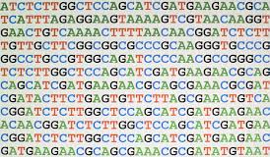
Genetic Data: What Is It?
Definition: Information derived from a person's DNA
Collection Methods: Blood tests, saliva samples, tissue biopsies
Details Captured: Genetic variants, hereditary risk factors
Applications: Diagnosis, understanding diseases, drug response, personalized medicine
Unique Nature: Each person's genetic data is distinct and sensitive

Slide 9
Use and Protection of Genetic Data
Clinical Uses: Diagnosing genetic conditions, guiding treatments
Research Applications: Studying hereditary diseases, developing therapies
Privacy Concerns: Risk of discrimination or misuse if data is not protected
Protection Measures: De-identification, access control, informed consent
Regulations: GDPR

Slide 10

Real-World Data (RWD)
Definition: Data collected outside traditional clinical trials
Sources: EHRs, claims databases, patient registries, wearable devices
Applications: Understanding treatment effectiveness in real-life settings
Advantages: Reflects diverse patient populations, large-scale data
Challenges: Data quality, consistency, and privacy concerns

Slide 11

Artificial Intelligence (AI) in Healthcare
Definition: AI uses algorithms to analyze complex healthcare data
Applications: Predicting patient outcomes, automating diagnoses, personalized treatment plans
Benefits: Improves accuracy, speeds up data analysis, supports decision-making
Challenges: Data bias, transparency, and ethical concerns
Future Potential: Enhancing patient care through advanced predictive analytics

Slide 12
Data Protection and Privacy
Key Principles:
  Confidentiality: Protecting patient identity
  Integrity: Ensuring data accuracy
  Availability: Accessible only to authorized personnel
Regulations:
  GDPR (General Data Protection Regulation)

Slide 13
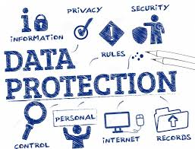
How Data Protection Affects Data Use
For Clinical Use:
  Strict protocols for data access
  Regular audits to ensure compliance
For Research:
  De-identification or anonymization of data
  Ethics committee approvals required

Slide 14
Key Takeaways

Slide 15
Key Takeaways
1
2
3
Data is vital for patient care and medical research
Understanding how data is collected and used helps build trust
Patients have rights to data privacy and protection

Slide 16
Questions and Discussion

Slide 17
Thank you!

