Slide 1
Welcome!
We will be starting shortly…
Use your real name
Mute yourself when not speaking
Turn your camera on, if comfortable
Use the chat box for questions
Or raise your hand to use your microphone
Please note that this training will be recorded. The recording will be available for participants only.

Slide 2
Rare Disease Week 2024
EURORDIS Advocacy Team

Slide 3
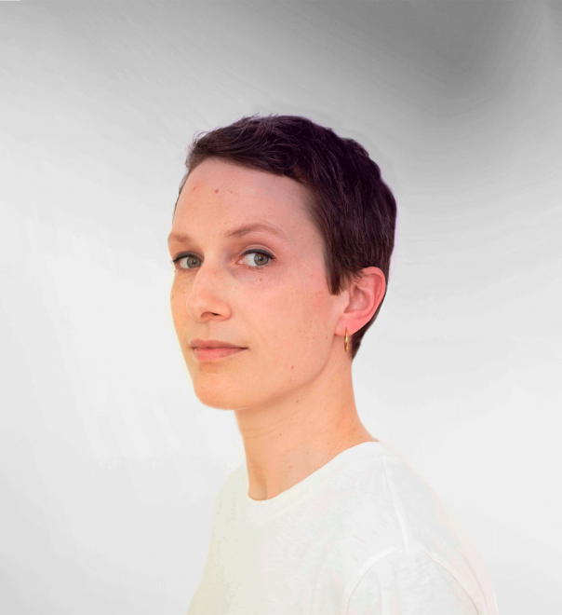
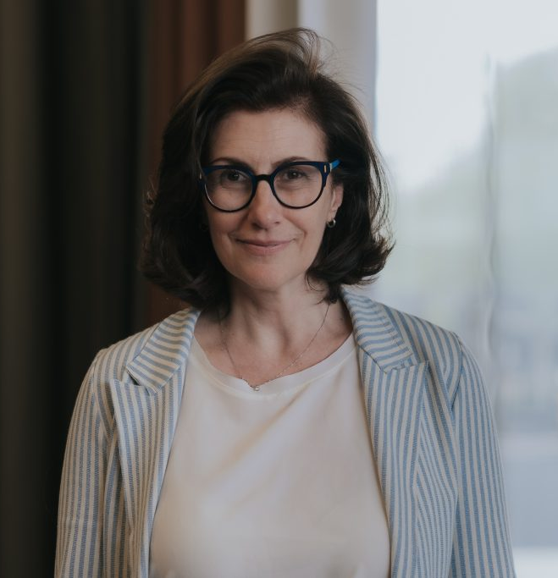
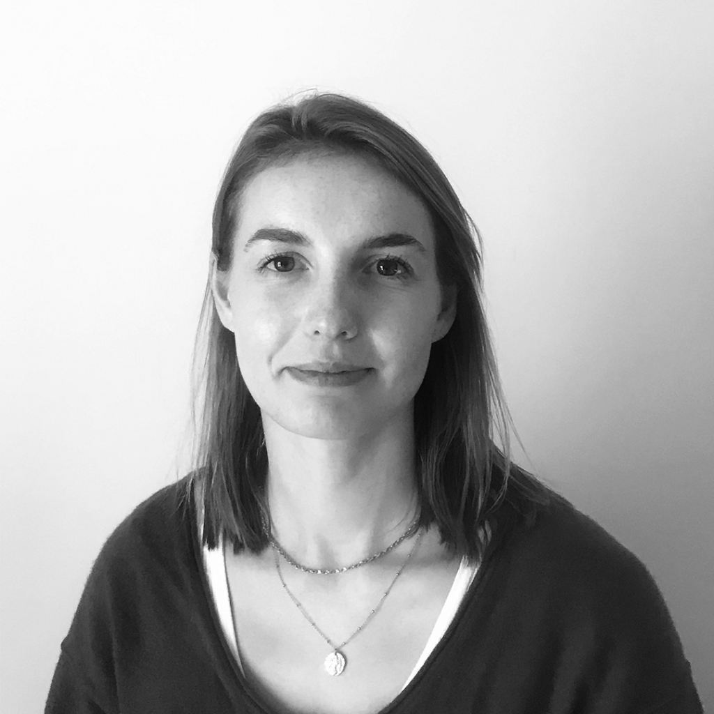
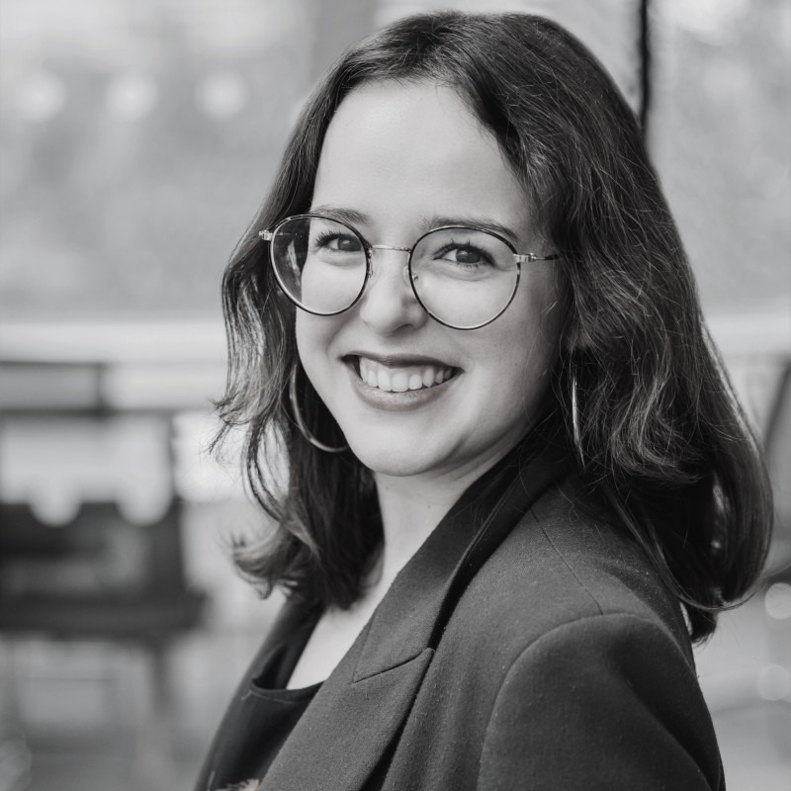
Meet the RDW24 Team
Julie Pernet, European Public Affairs Senior Manager
Valentina Bottarelli, Public Affairs Director & Head of European Advocacy
Rachel Butcher, Public Affairs Manager
Solène Jouan, EU Public Affairs Manager

Slide 4
20 participants, 20+ rare diseases

Slide 5
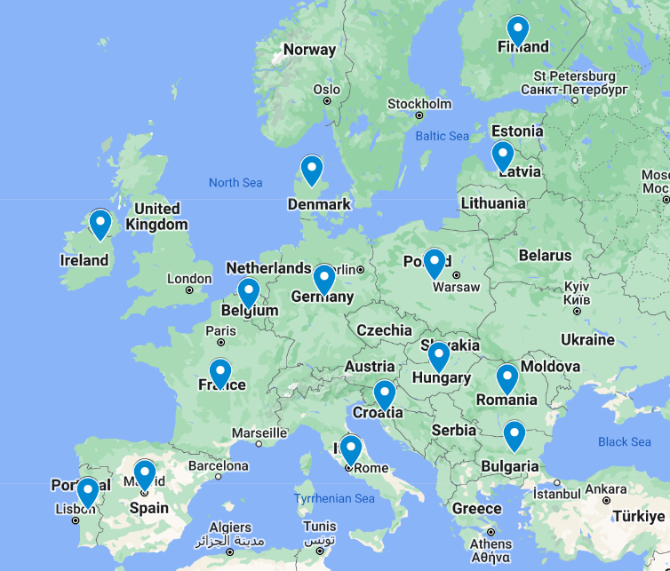
20 participants, 15 countries

Slide 6
Introducing each other!
You will be put into breakout groups in pairs for 5 mins
Interview your partner, find out their name, country, organisation they represent then a fun fact that you think the rest of the group should know
It could be anything, such as:
Where they would like to travel the most and why
Would they rather spend a week in the past or the future
What is a hobby they would like to pick up or start again…
Introduce your partner to the group when the breakout ends and get to know all your fellow participants a bit better!

Slide 7
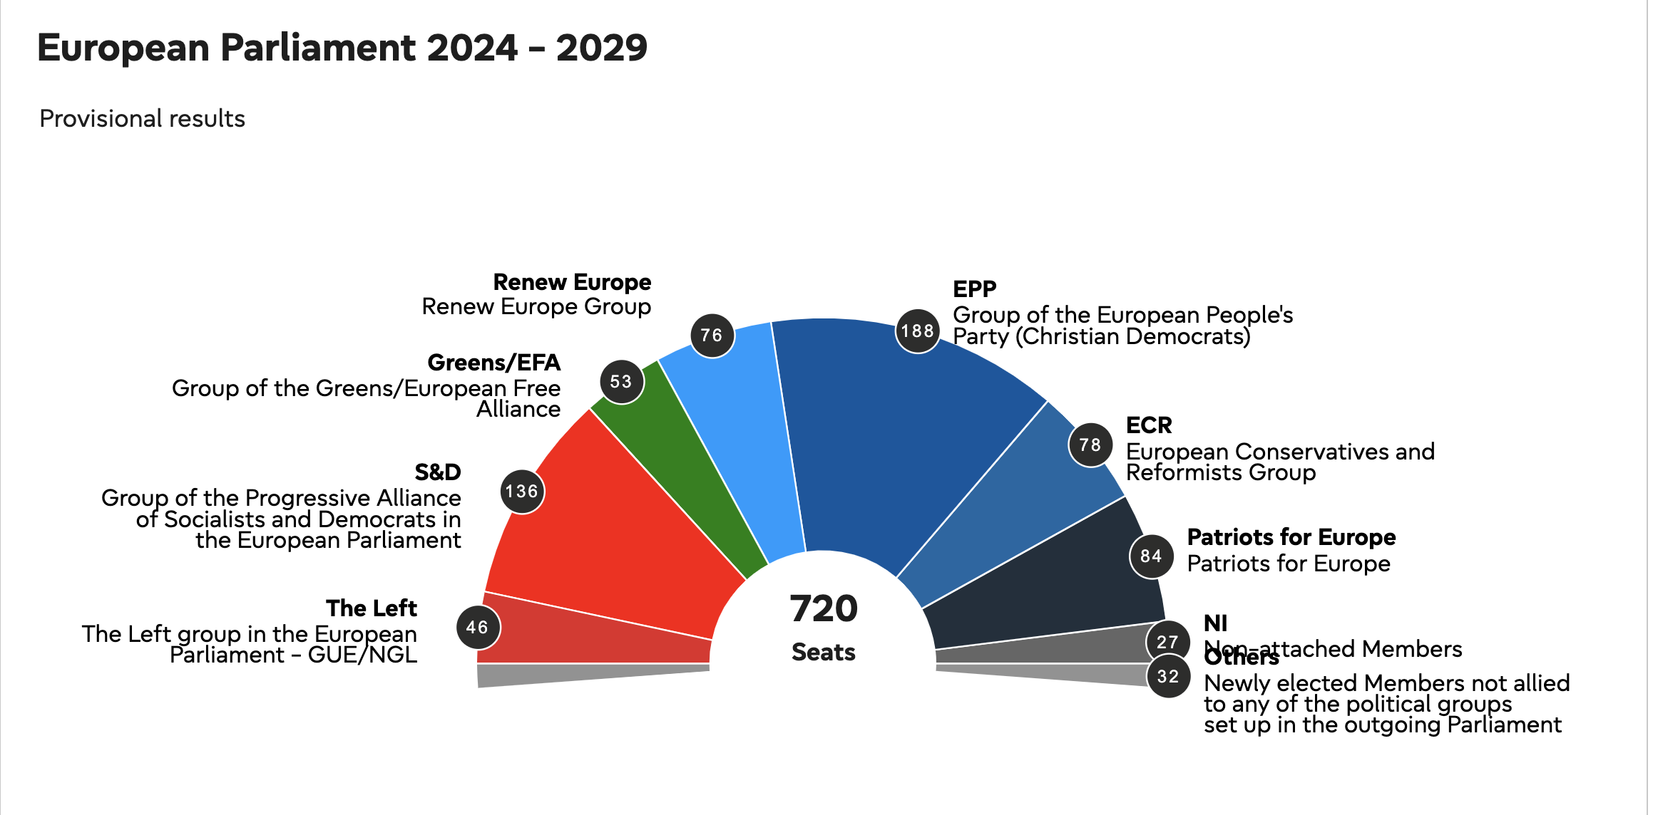
Training context : new political leaders... and a brand new EP !

Slide 8
What to expect ?
Results :
The EPP scores a clear victory
S&D and the left remain stable
Renew Europe and the Greens decrease
Far-right wins big and new group "Patriots for Europe"
=> Far-right wins out over the liberals
=> Uncertain coalitions
=> Health not high on the agenda
We need to re-build our network of allies

Slide 9
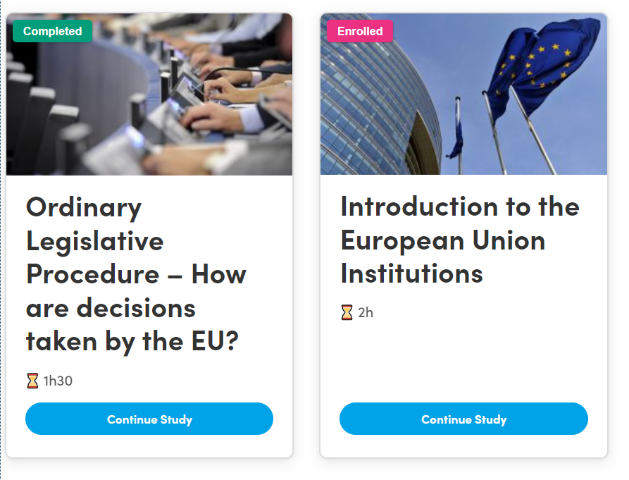
Pre-training: e-learning

Slide 10
Pre-training: webinars
Webinar #1 – Kick-off meeting – 09/07/2024
Rachel, Julie
Webinar # 2 - Advocacy Skills – 01/10/2024
Han Valk, HVFC
Webinar # 3 - Negotiation Skills – 29/10/2024
Han Valk, HVFC
Webinar # 4 – Preparing for the training week – 08/11/2024
Rachel, Julie
Notes:
HVFC is a consultancy that works with impact-driven organizations to help them diversify funding, increase impact, and build capacity.

Slide 11
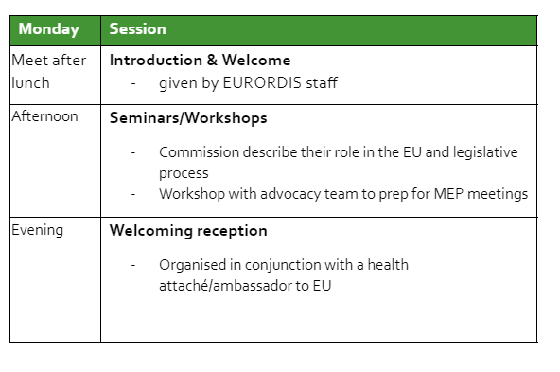
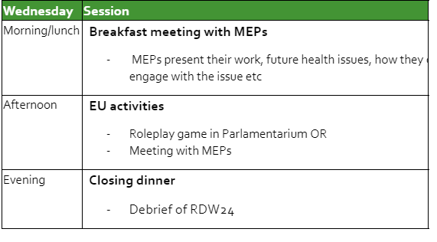
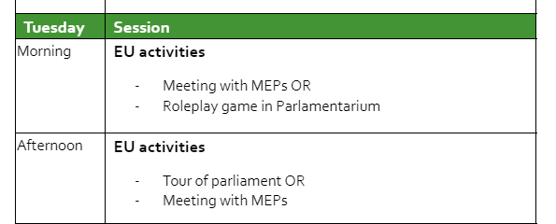
In-person agenda

Slide 12
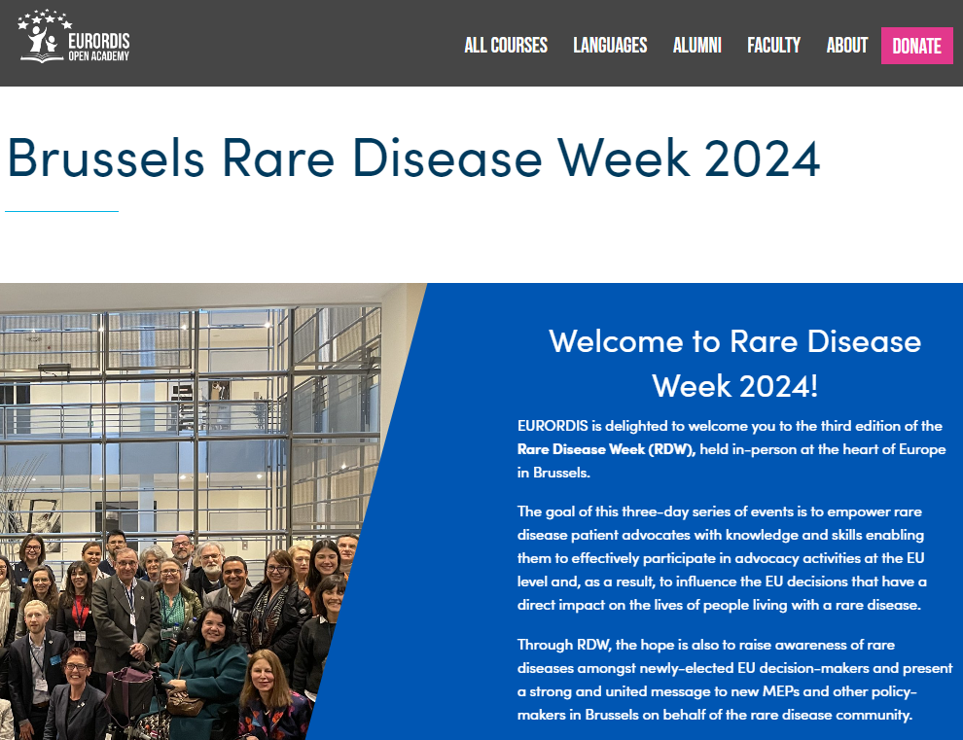
Logistics

Slide 13
Rare Disease Week 2024 18-20 November
Brussels, Belgium
Thank you!

